Slide 1
Alternativy
ladění
sítě
Václav Nesvadba Faster_3.0

Slide 2
použité technologie
pokročilé
- juniper ...
jednoduché
- mikrotik ...
otevřený HW
- whitebox + (cumulus)linux + BIRD ...
vlastní HW
- unipi.technology PLC/IoT
open source
- linux, freebsd, openvswitch ...

Slide 3
šetřit adresy
peering
a.b.c.d/30 :( a.b.c.d/31 a.b.c.d peer e.f.g.h
mikrotik
ADDRESS NETWORK INTERFACE
10.20.188.169/32 10.20.188.168 combo1
linux
ip ad add 172.30.1.1 peer 172.30.1.128/29 dev swp1
echo 1 > /proc/sys/net/ipv4/conf/swp1/proxy_arp
ip ro fl type broadcast dev swp1 src \
172.30.1.1 table local
# Nezkoušet na IPv6 !

Slide 4
šetřit zdroje
ochrana proti útokům na neighbor cache (4096)
menší routing table
router IP
default 2a02:e98:10:5410::1/120 (16 subnets )
up to /116 (256 subnets)
subnety
zak-A 2a02:e98:10:5410::20/124
( použít adresy 22 ... 2e/64 pro stěhování )
zak-B 2a02:e98:10:5410::30/124
( routovat net /60+ via ::32 )
peering
185.146.4.112/31
2a02:e98:1:4::112/127

Slide 5
efektivní rekonfigurace
.
f_netadmin(django)
f_flyif

Slide 6
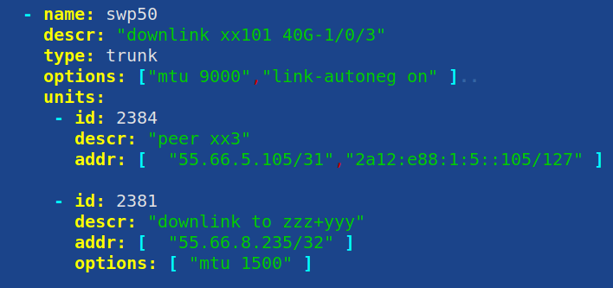
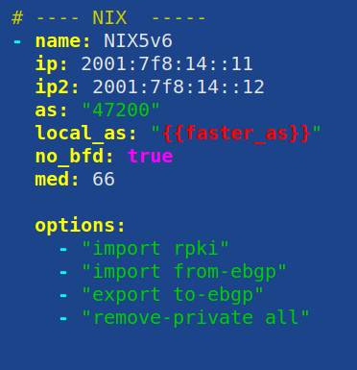
efektivní rekonfigurace
ansible + f_modules(bird,juniper,switch,firewall...)
ifupdown2

Slide 7
zvýšit dostupnost - VRRP
keepalived
/etc/keepalived/keepalived.conf
vrrp_instance swp1 {
notify notify-broifc.sh
interface swp1.1234
state BACKUP
virtual_router_id 106
priority 100
authentication {
...
} }
f_cl-ifc
swp1.1024 UP,LOWER_UP 172.16.8.1:172.16.8.176/29 10.168.128.17:10.168.128.9/32 2a02:e98:0:5001::1/64
swp1.1025 UP,LOWER_UP 192.168.229.209/28 192.168.228.57/29
swp1.1026 UP,LOWER_UP 192.168.244.209/29 192.168.244.169/29 192.168.229.249/29 192.168.244.233/29
swp5.1027 UP,LOWER_UP 192.168.229.65/28
---- status ----
admin@rc6xx:mgmt:~# vrrp-show
/var/run/vrrp.pid:3811
/var/run/vrrp.swp1:MASTER
/var/run/vrrp.swp5:BACKUP
/var/run/vrrp.swp51:BACKUP
/var/run/vrrp.swp53:BACKUP

Slide 8
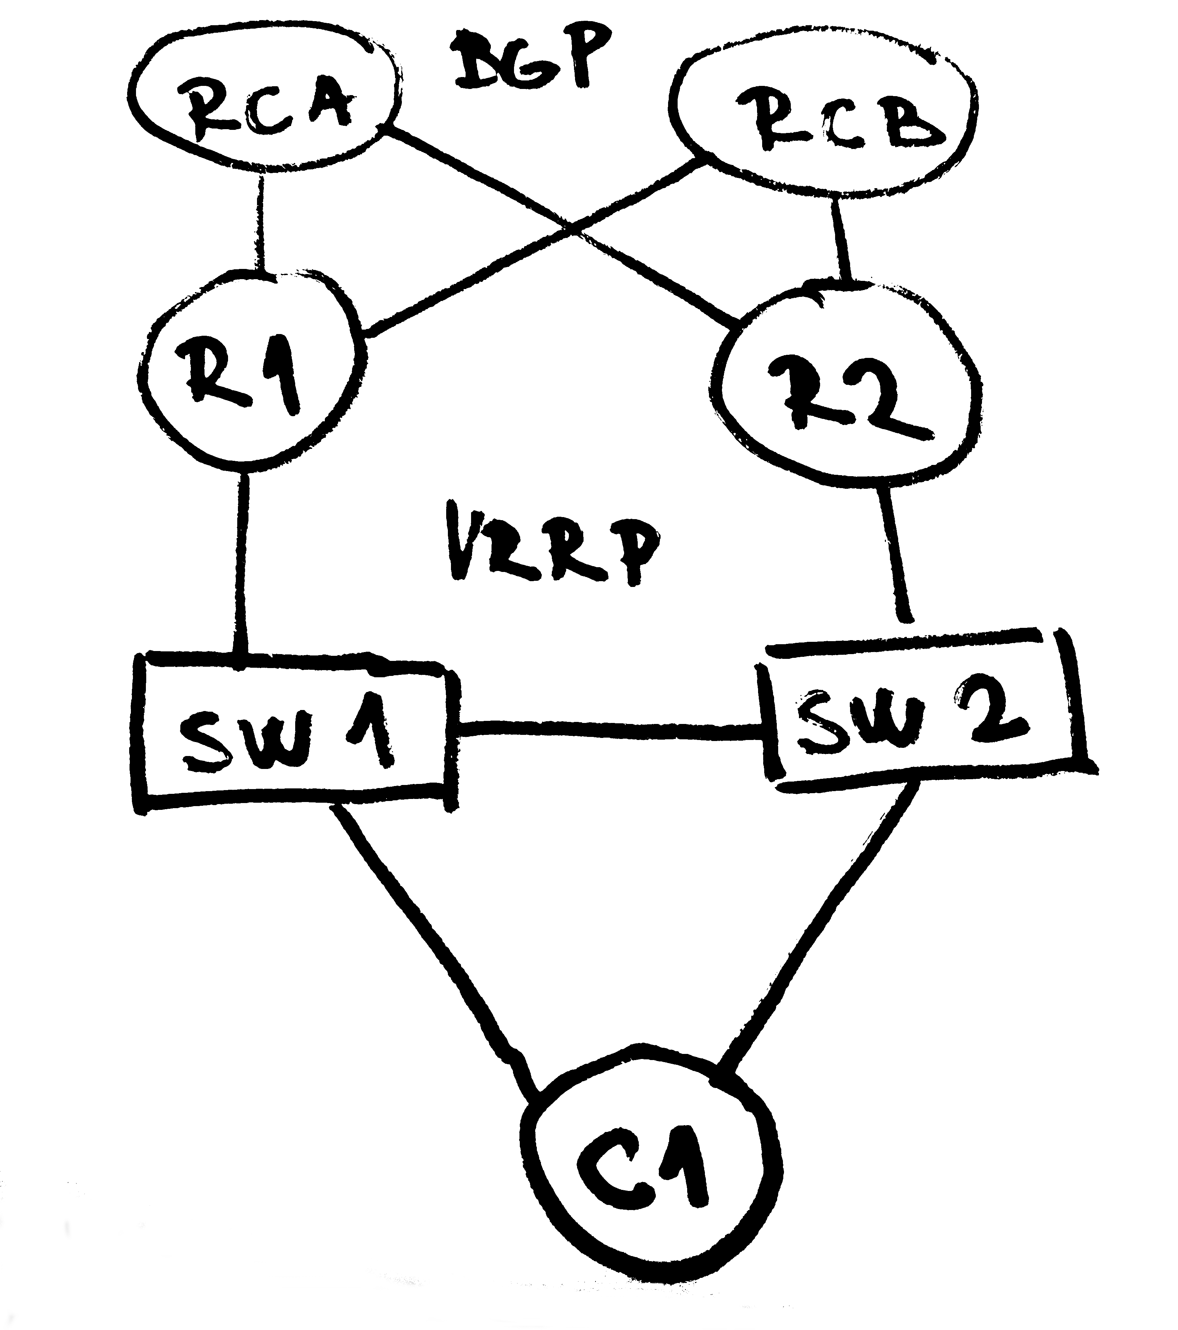
zvýšit dostupnost - VRRP
f_brother + f_flyif
/etc/keepalived/brother-hosts.conf
10.11.7.235 swp51
10.11.7.237 swp53 swp5
--- log -----
flyif[4721] request cmd: -r swp5 MASTER
flyif[4721] runnin vrrp_ON cmd: -r swp5 MASTER
flyif[4721] IFC: swp1 vrrp_ON cmd: -r swp5 MASTER
flyif[4721] IFC: swp5 vrrp_ON cmd: -r swp5 MASTER
flyif[6125] request cmd: -r swp5 BACKUP
flyif[6125] waitin cmd: -r swp5 BACKUP
flyif[4721] finished vrrp_ON cmd: -r swp5 MASTER
flyif[6125] runnin vrrp_ON cmd: -r swp5 BACKUP
flyif[6125] IFC: swp1 vrrp_ON cmd: -r swp5 BACKUP
flyif[6125] finished vrrp_ON cmd: -r swp5 BACKUP

Slide 9
zvýšit dostupnost - VRRP+BGP
f_ifwatch
ifwatch interface_name minimum_packet_count watch_time
bird R1
/etc/bird/peers/rca.ibgp
...
export filter { # to upstreams
...
if ifname ~ "swp1.*" then {
include "/etc/bird/prepend.live.swp1";
}
if ifname ~ "swp5.*" then {
include "/etc/bird/prepend.live.swp5";
}
...
};
/etc/bird/prepend.live.swp5
bgp_prepend(myas);

Slide 10
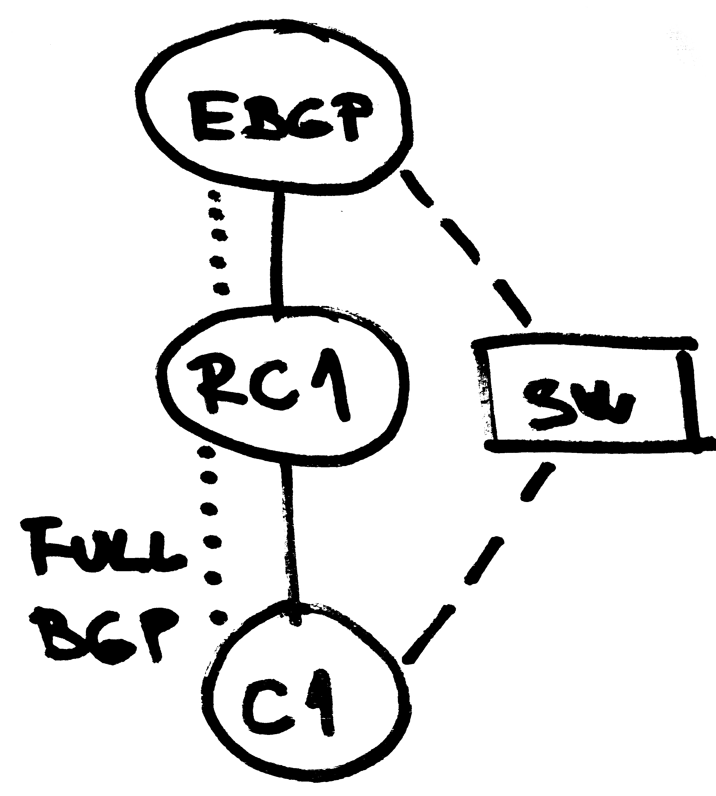
zvýšit dostupnost – FULL BGP
bird RC1
2x fullbgp table IPv4+IPv6 < 500MB
/etc/bird/peers/zakaznici.bgp
protocol bgp c1_a { # peer C1
table fullbgp;
import limit 1100000 action block;# upstream
...
import filter {
# custom
bgp_community = add(bgp_community,(24641,65199));
if net = 22.33.98.0/24 then
bgp_community = add(bgp_community,(24641,2001));
bgp_accept([55.66.188.48/28,22.33.98.0/24]);
bgp_reject(ALL);
};
...
};

Slide 11
zvýšit dostupnost – FULL BGP
bird RC1
/etc/bird/peers/fullbgp.table
# vymena rout mezi VRF
table fullbgp;
protocol pipe fullbgp_pipe {
peer table fullbgp;
# export filtruje z main do peer
export filter {
reject;
};
# import filtruje z peer do main
import filter {
if bgp_community ~[(24641,65199)] then accept ; else reject;
};
}

Slide 12
zvýšit dostupnost – more ...
výpadek konektivity upstreamu a defaultgw se pořád propaguje?
bird: if ( fullbgp route count > X ) = propaguji defaultgw
problémy s větším počtem RTBH do některých upstreamů
f_magnet: advertise /24 do lepšího upstreamu + RTBH
interní statistika bajty/pakety/toky, nárust > 250% = DDoS
f_rtbh_api: automaticky RTBH + ovládání přes dohled

Slide 13
open source HW

Slide 14
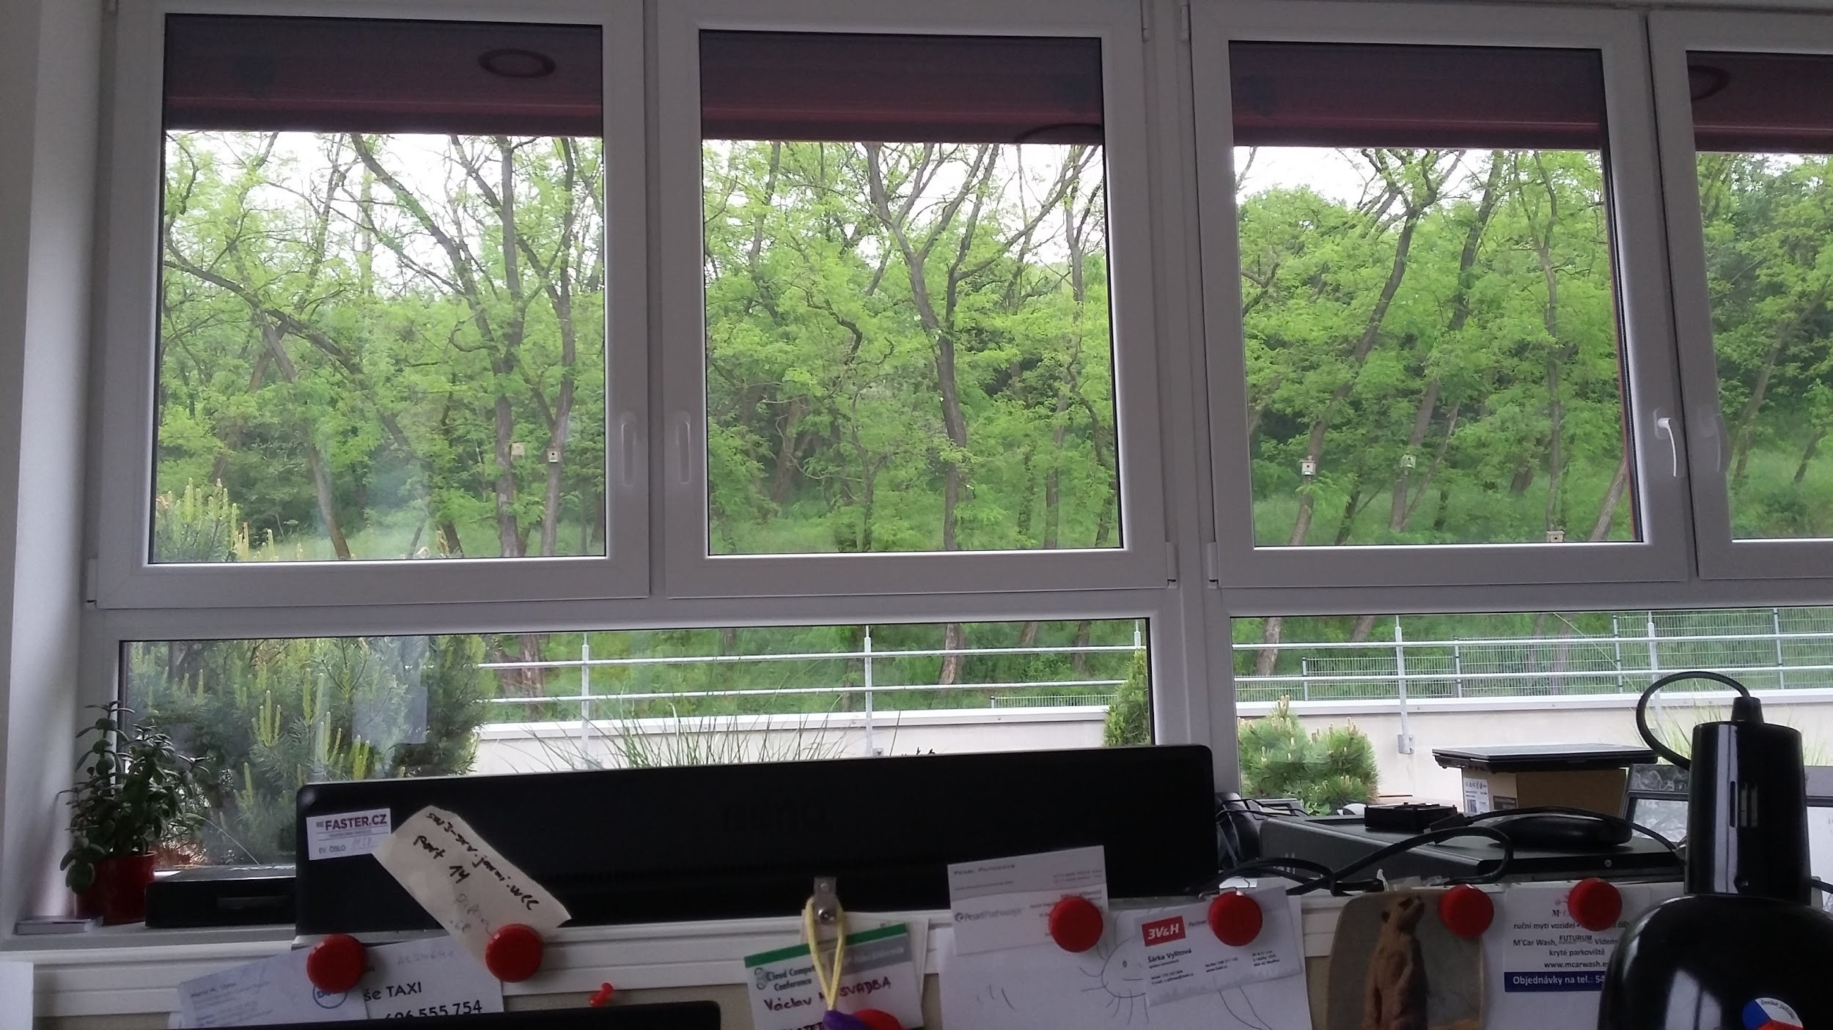
Q&A
venca@faster.cz

