Slide 1
Infrastructure monitoring
Marian Rychtecký
& NIX.CZ Dev team

Slide 2
NX OS DME
What you get ?
Speed
Requests takes milliseconds (full switch setup ~5s)
Individual requests (interface, VLAN, VNI, BGP settings) ~100ms
Reliability of the REST API
Operational parameters

Slide 3
NX OS DME
(templates translating)
POST /api/mo/sys/snmp/inst.json
{
"snmpInst": {
"children": [
{
"snmpSysInfo": {
"attributes": {
"sysContact": "email@domain.cz",
"sysLocation": "Site 1, Prague, CZ"
}
}
}
]
}
}
snmp-server contact email@domain.cz
snmp-server location Site 1, Prague, CZ

Slide 4
Collecting objects
"rmonIfIn": {
"attributes": {
"broadcastPkts": "3",
"clearTs": "never",
"discards": "0",
"dn": "sys/intf/phys-[eth1/5]/dbgIfIn",
"errors": "0",
"modTs": "2023-07-11T09:44:04.692+00:00",
"multicastPkts": "1995153",
"nUcastPkts": "1995156",
"noBuffer": "0",
"octetRate": "4947614883",
"octets": "60673271644077186",
"packetRate": "5404507",
"rateInterval": "300",
"ucastPkts": "63082941837541",
"unknownEtype": "0",
"unknownProtos": "0"
}
}
}

Slide 5
Statistics in the real world
Network device (Cisco Nexus 9300)
DME API
Traffic weather map
API
Netbox
External Graphs
Internal Graphs
Python
code
Influx API

Slide 6
Collecting objects
Collecting data every 30s
Data pre-processing (calculated items)
Saving data to TSDB

Slide 7
Scale
We collect
37 devices
2339 interfaces
63080 metrics

Slide 8
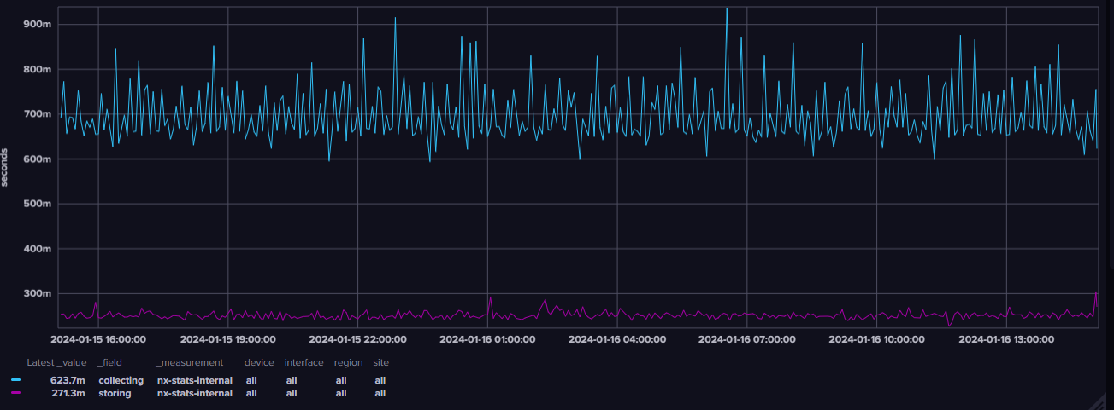
Collection and storing
700ms to collect
250ms to store

Slide 9
Data handling – InfluxDB 2
“main” bucket
~4GB / month
daily bucket (7MB/d)
5 minutes AVG, MEAN, MAX
RAW data – 30s intervals
weekly bucket (17MB/w)
30 minutes AVG,MEAN,MAX
monthly bucket (35MB/M)
2 hours AVG, MEAN, MAX
Down-sizing tasks
yearly bucket (~38MB/y)
1 day AVG, MEAN, MAX

Slide 10
Data handling – InfluxDB 2
Flux script example
from(bucket: “main")
|> range(start: -task.every)
|> filter(fn: (r) => r["_measurement"] == "nx-stats")
|> aggregateWindow(every: 30s, fn: sum)
|> aggregateWindow(every: 1d, fn: mean)
|> set(key: "_measurement", value: "mean")
|> toInt()
|> to(bucket: “stat_year")

Slide 11
Data handling – InfluxDB 2
main bucket
30 sec AVG, MEAN, MAX
daily bucket
5 minutes AVG, MEAN, MAX
weekly bucket
30 minutes AVG,MEAN,MAX
Flux lang
Python HTTP API
monthly bucket
2 hours AVG, MEAN, MAX
yearly bucket
1 day AVG, MEAN, MAX

Slide 12
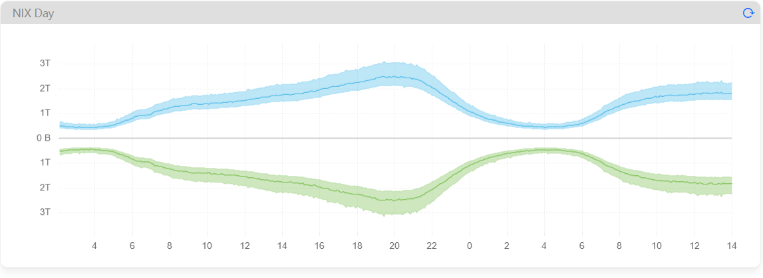
Data handling – InfluxDB 2
Visualization using uPlot

Slide 13
Data handling – InfluxDB 2
Visualisation using uPlot

Slide 14
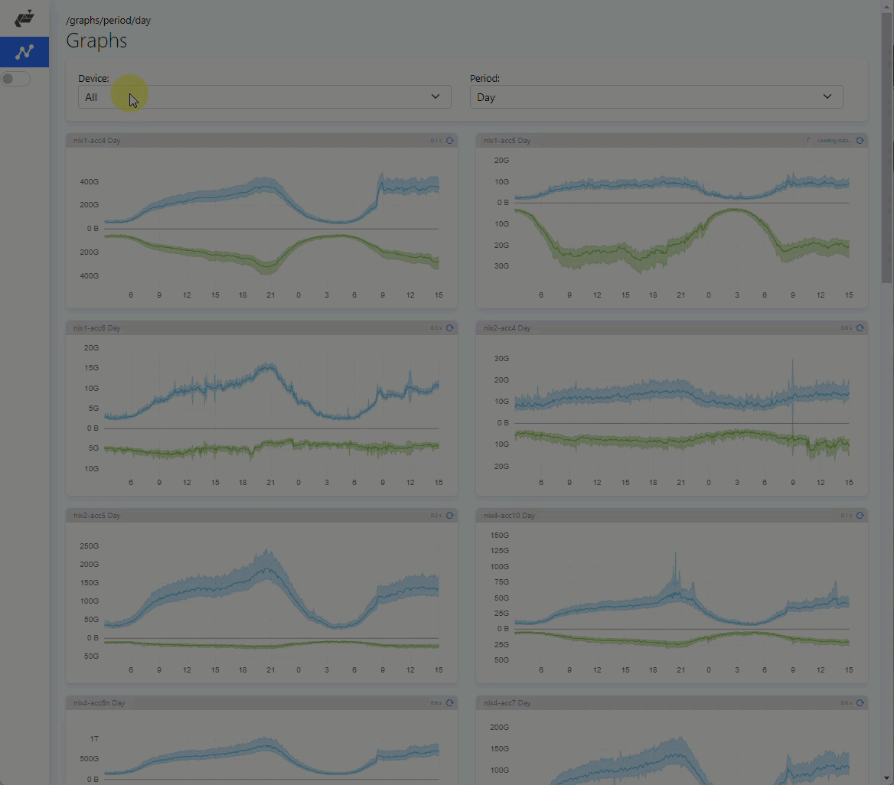
Data handling – InfluxDB 2

Slide 15
Weathermap using InfluxDB
Network device (Cisco Nexus 9300)
API
Weathermap template
API
Netbox
Python
code
Processed data with template variables
Python
HTTP API
Processing CDP, link speeds and loads
Influx DB

Slide 16
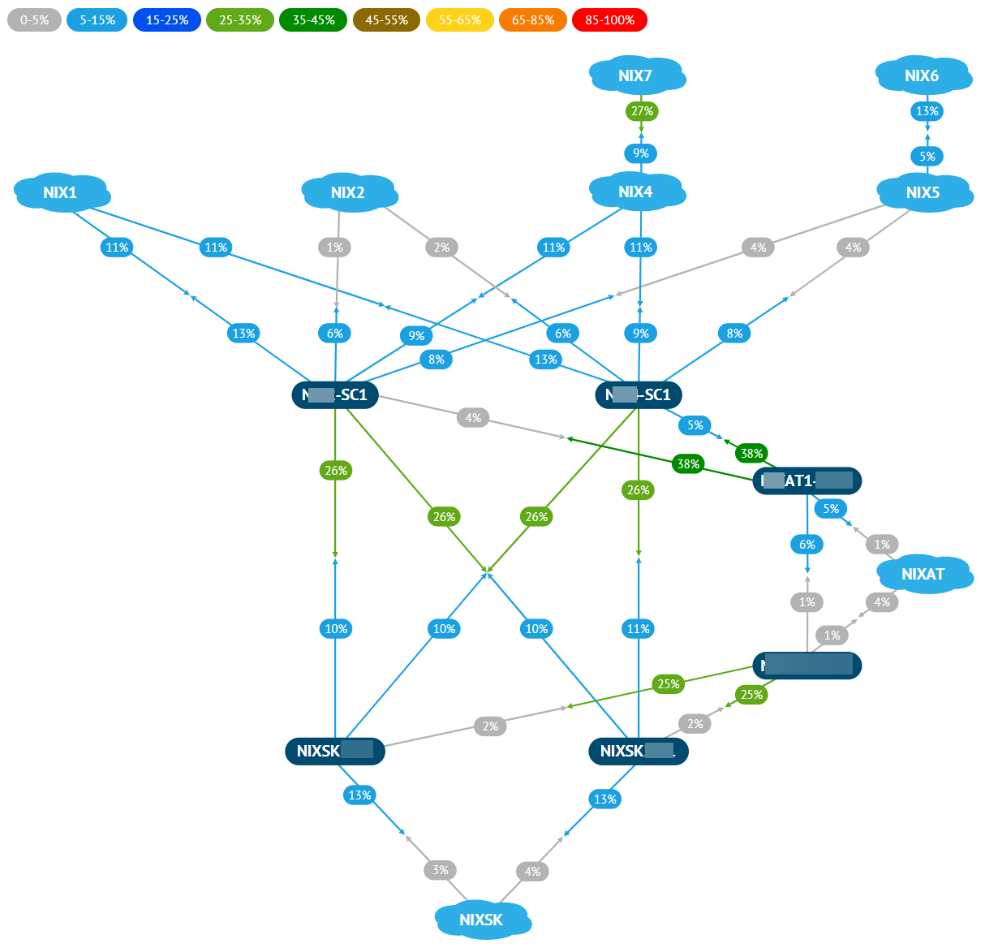
Weathermap using InfluxDB

Slide 17
Real life scenario - DDoS
Traffic bit/s
Max 14.88G
Discards p/s

Slide 18
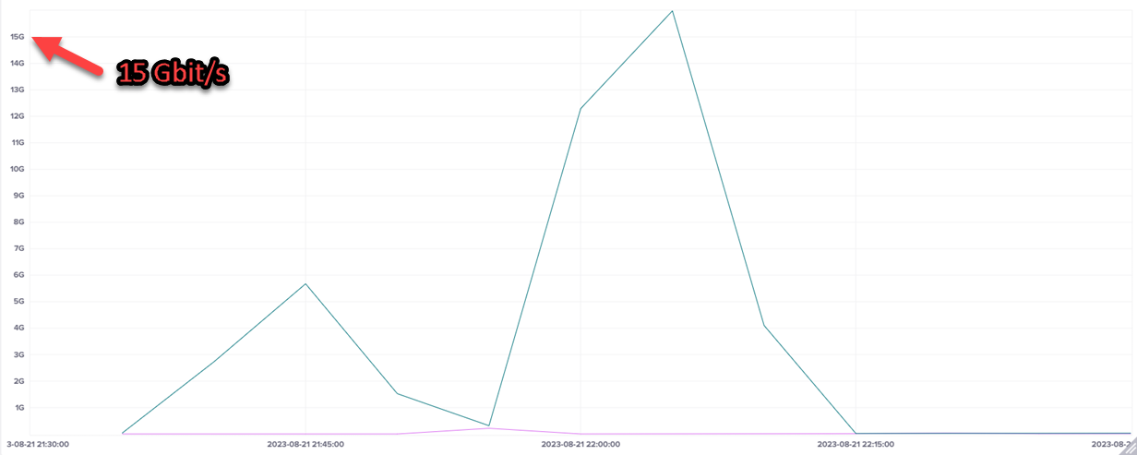
Real life scenario - DDoS
30s intervals averaged in 300s window

Slide 19
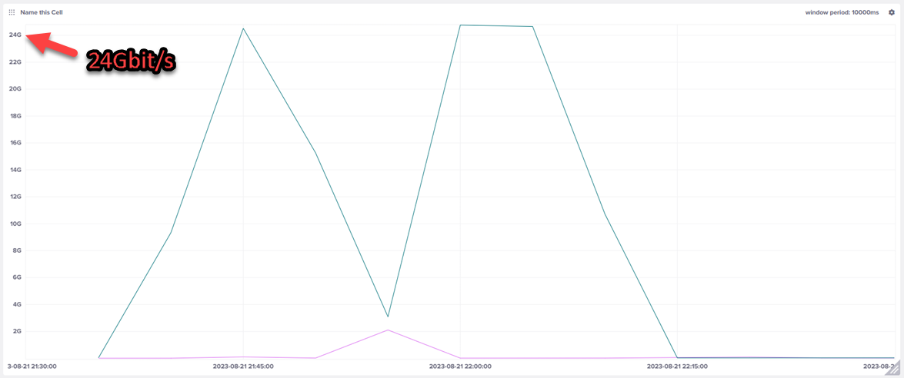
Real life scenario - DDoS
30s intervals max in 300s window

Slide 20
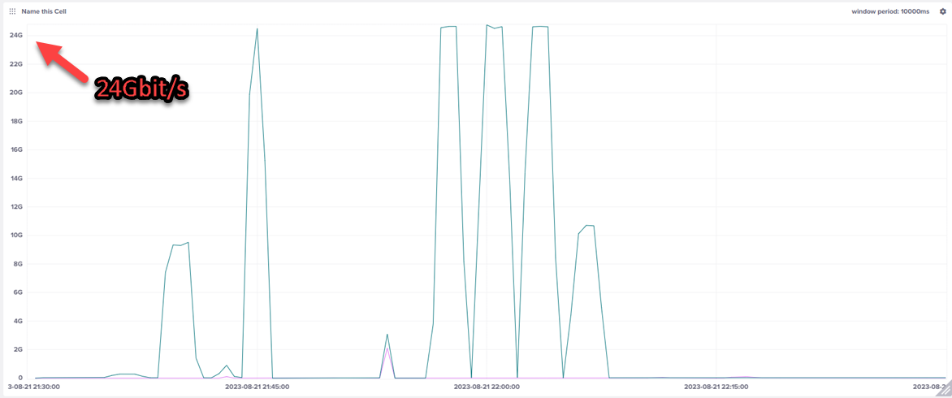
Real life scenario - DDoS
30s intervals maximums

Slide 21
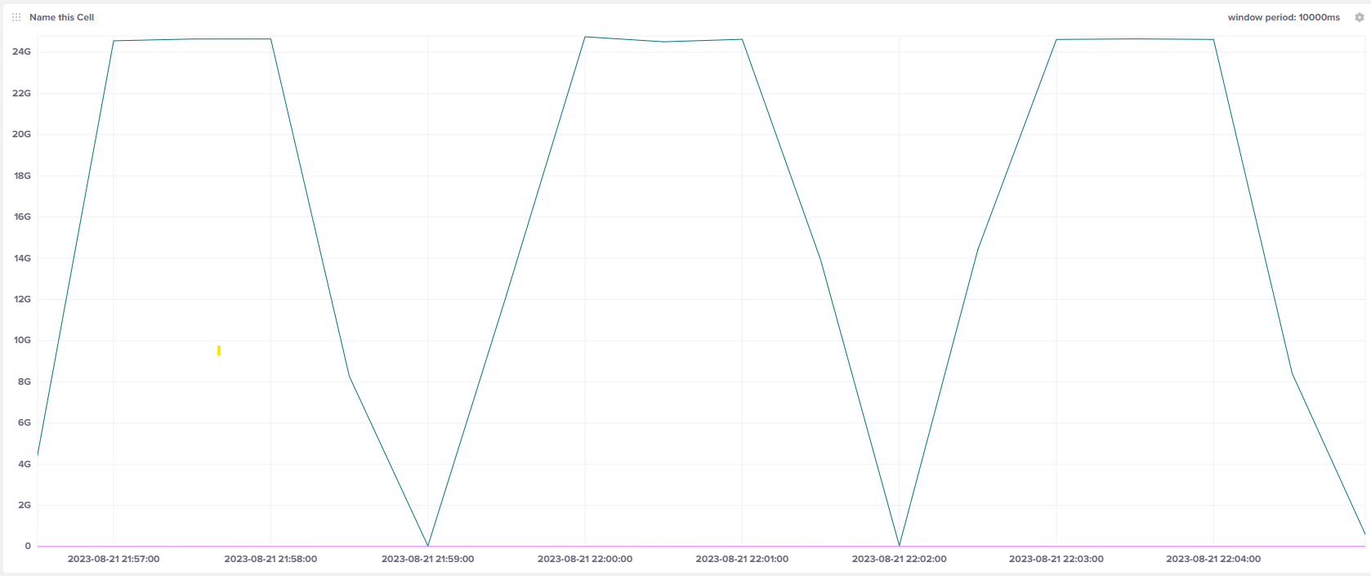
Real life scenario - DDoS
30s intervals maximums - zoomed

Slide 22
(s)Flow analysis
Network device (Cisco Nexus 9300)
sFlow
Weathermap template
Netbox
API
FTAS
Python
HTTP API
Python
code
Influx DB

Slide 23
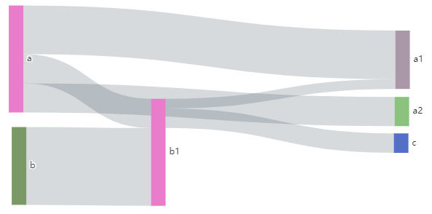
(s)Flow processing
~150 Mbit/s of sFlow samples
downsizing tasks
5 min statistics for day - 700MB/week
30 minutes statistics for week
2 hours statistics for month
1 day statistics for year
Sankey diagram

Slide 24
Thank you for your attention.
mr@nix.cz

