Slide 1


Slide 2
Our IT / Tech Community is one big family.
We don't think in colors, we don't think in races or genders, we don't think in borders.

Slide 3
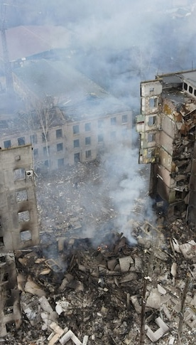
Keep Ukraine Connected
February 24, 2022
This was the day everything began.
War started in Ukraine.
Dark days for Ukrainian people,
but also for Internet Service Providers in the region.

Slide 4
Our IT / Tech Community is one big family.
We don't think in colors, we don't think in races or genders, we don't think in borders.

Slide 5
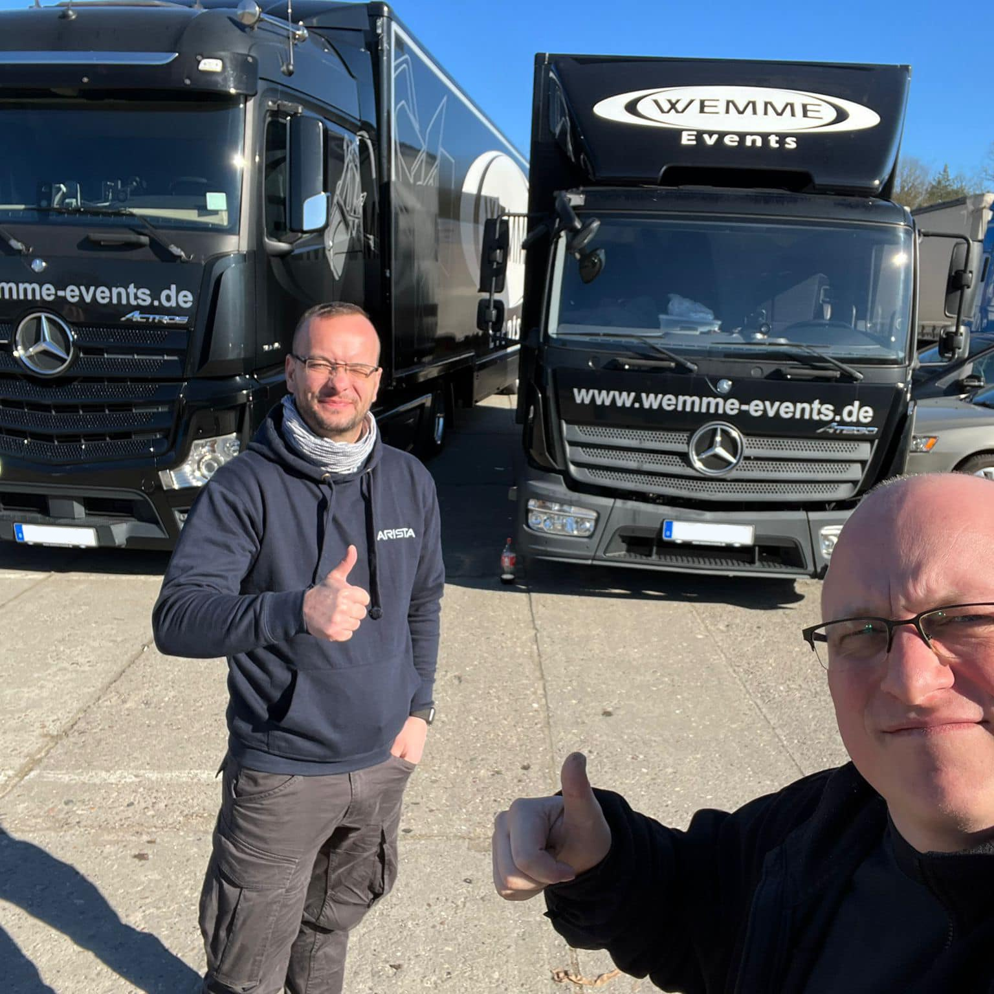
The beginning…
When Russia invaded Ukraine, our chair René Fichtmüller didn’t want to stand idly by. He first got together with his friend Patrick, and helped organise two truck’s worth of relief, which they dropped off at the Ukrainian border in the second week of March 2022.
However, of course, this was not enough.

Slide 6
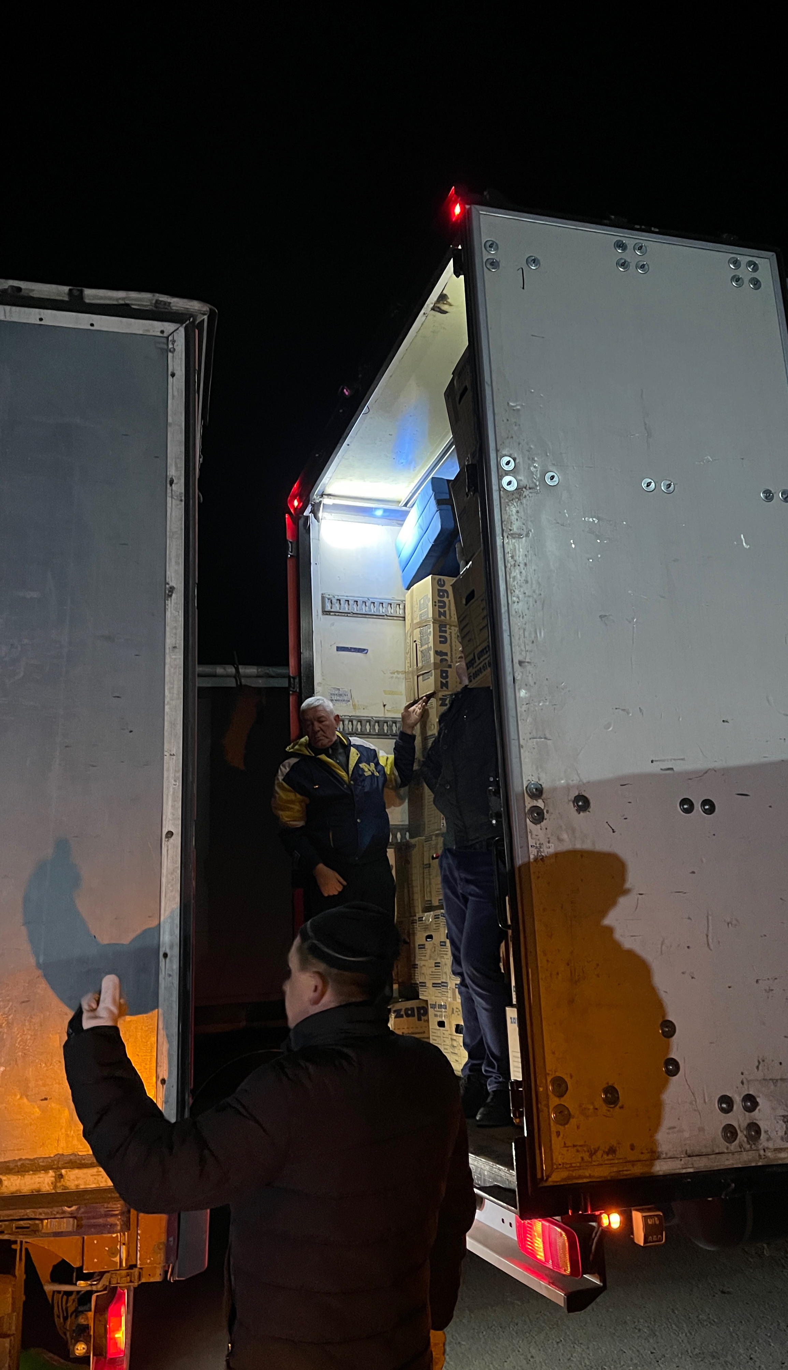

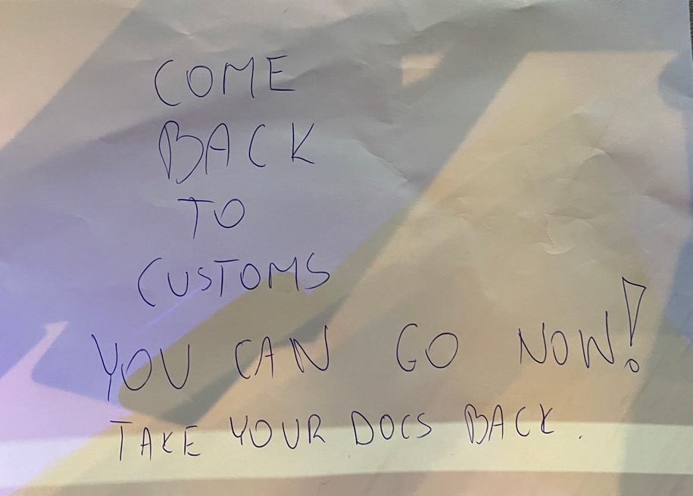
The first challenge:
Drive from Berlin to Ukraine. (11 hrs + 2 hrs sleep)
Meet strangers in a country where war is raging and unload all humanitarian goods from truck to truck and drive back as fast as possible. (2 hrs)
Then very quickly through local contacts, through gates that suddenly opened, back to the Polish side of the border. (3 hrs sleep)
Driving back home to Berlin again (13 hrs)
Done!
Or was it…

Slide 7
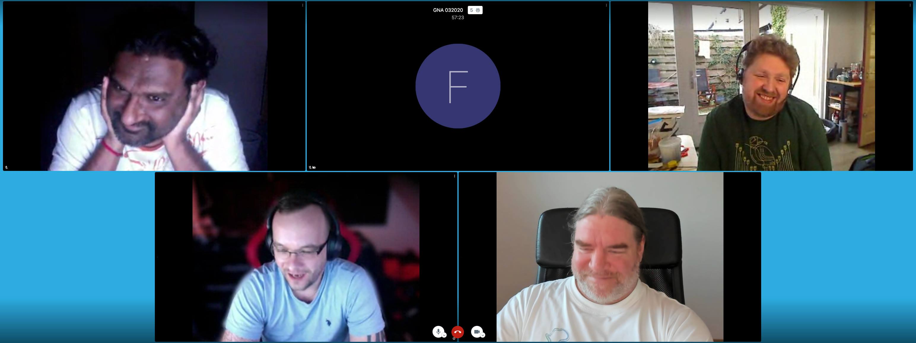
The next day…
At the Global NOG Alliance Board Meeting
Rene shared his thoughts on the next steps, and we all agreed that it was time to do exactly what the Global NOG Alliance was founded to do. Help Network Operators.
We called this task force:
Keep Ukraine Connected

Slide 8
Our vision & mission
We wanted to be the facilitator linking the Disaster Region and the global community.
We have contacts in the community and with the manufacturers. We wanted to use these contacts to do good things.

Slide 9
Strategy Development
We received many offers for donations and also many requests for equipment.
In order to be able to map this properly, we implemented a custom-made Supply & Demand Database.

Slide 10
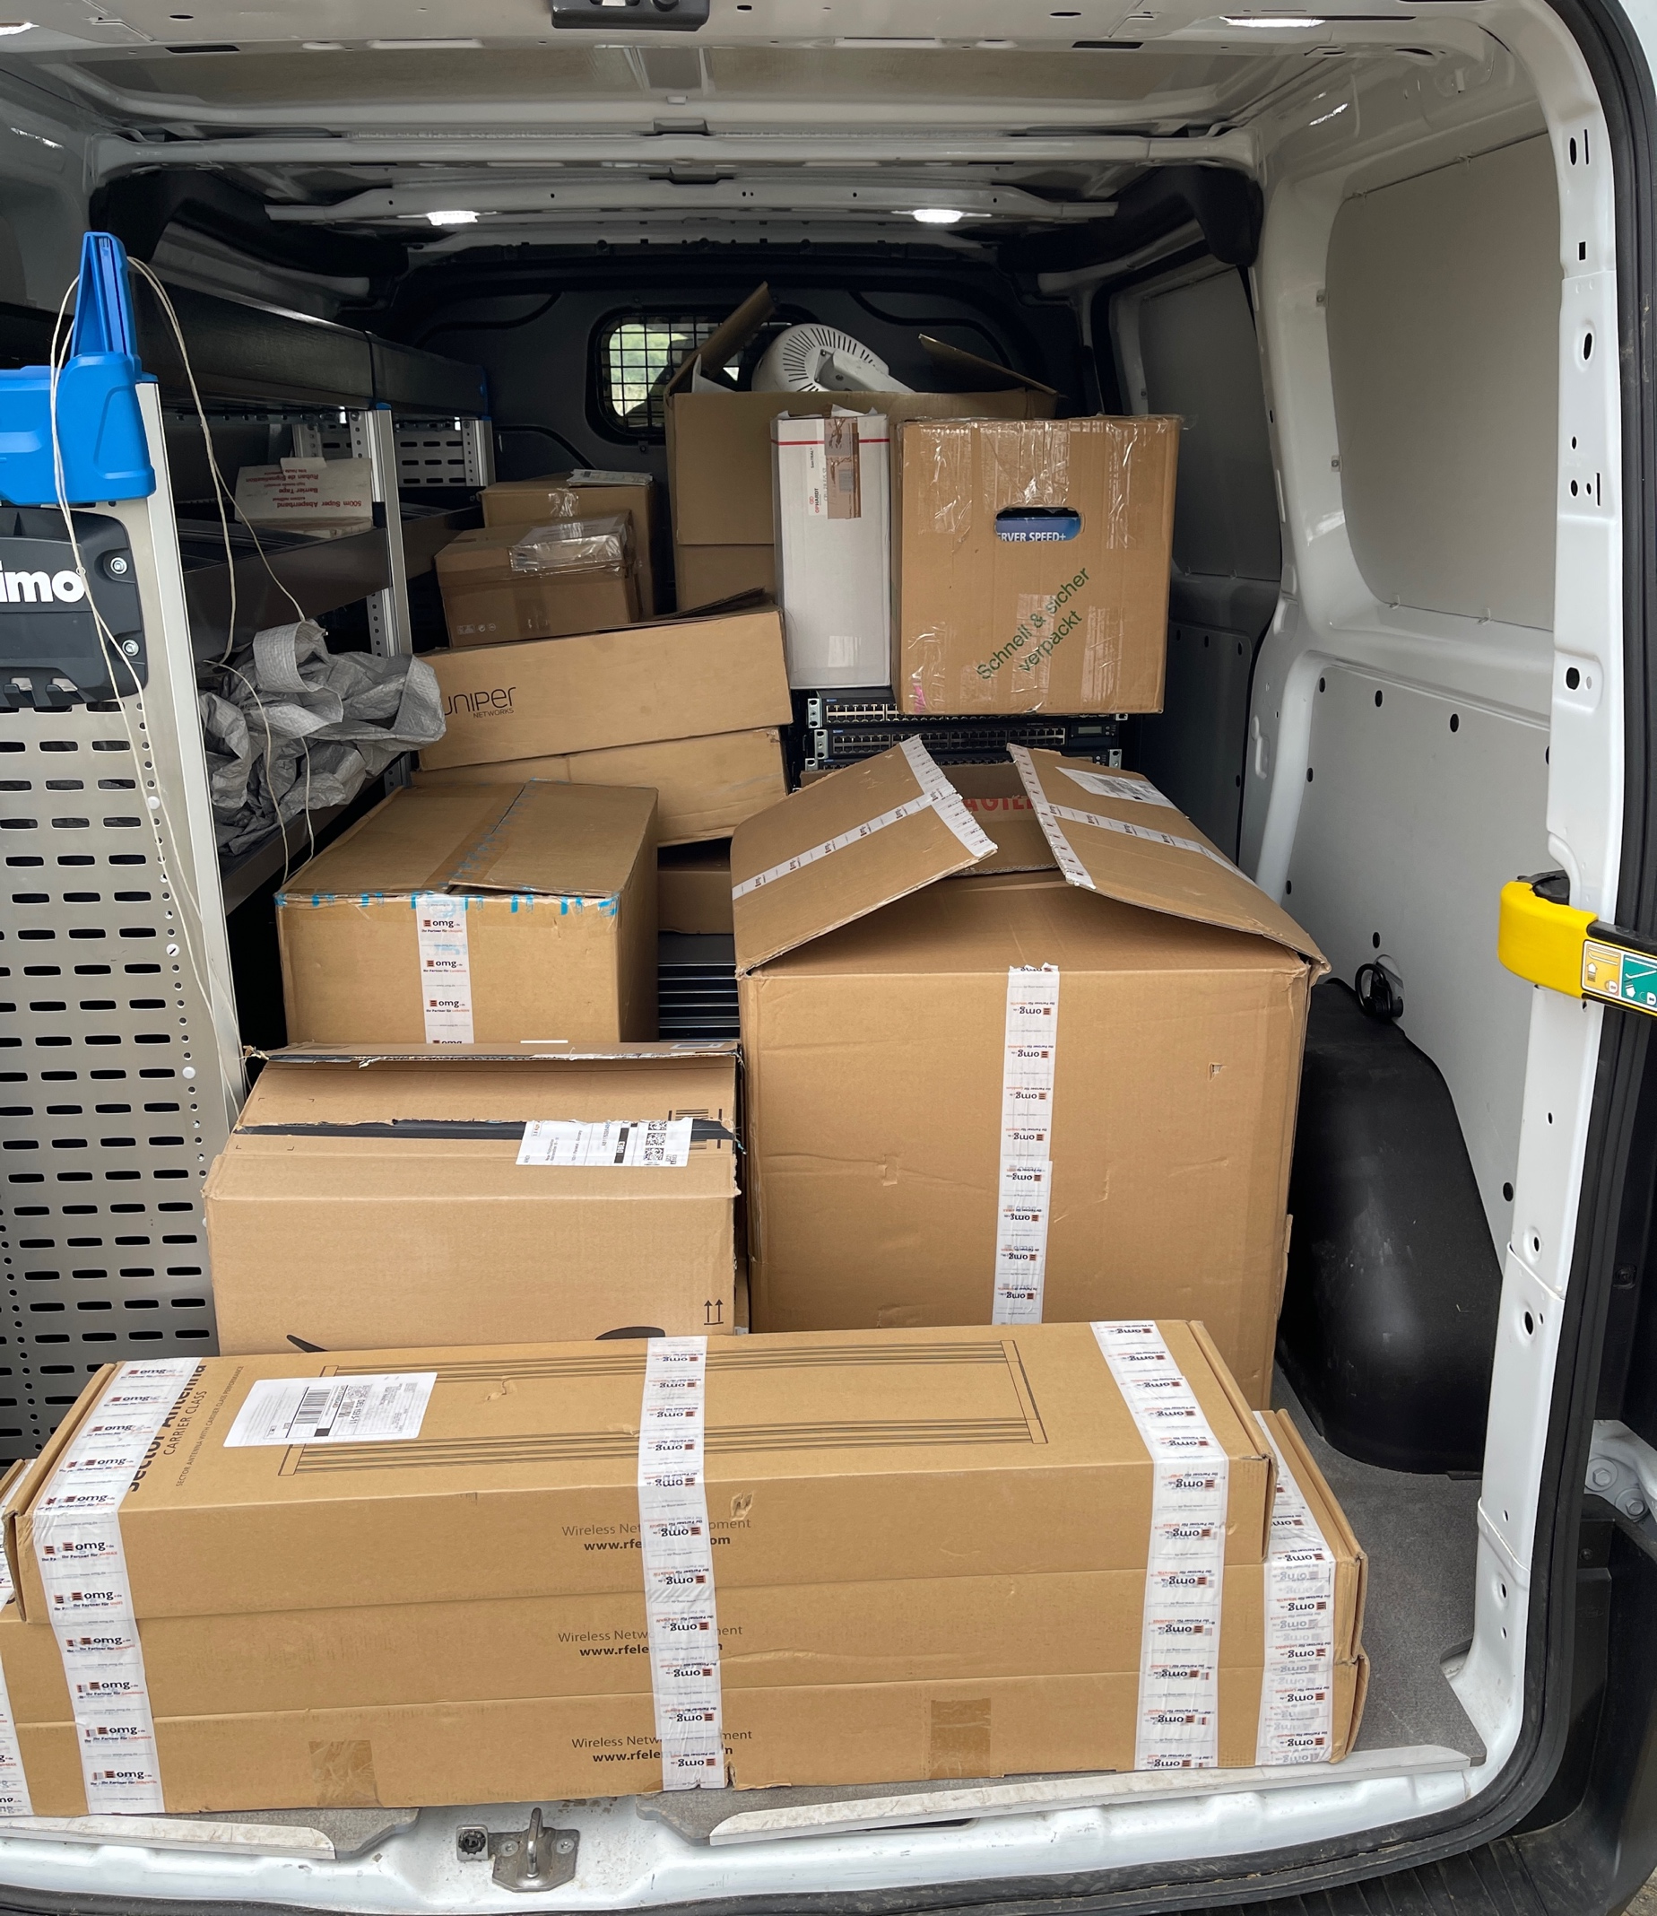
From a simple idea,
to supply chain managers…
The GNA Supply & Demand Database works very well. Anyone who wants to donate equipment can get a login from us, and can specify what they want to donate.
Using this database, we can manage which donations we‘ve received. This makes it easier for us to keep track of everything, and means we can show people from Ukraine who need equipment what we have in the system.

Slide 11
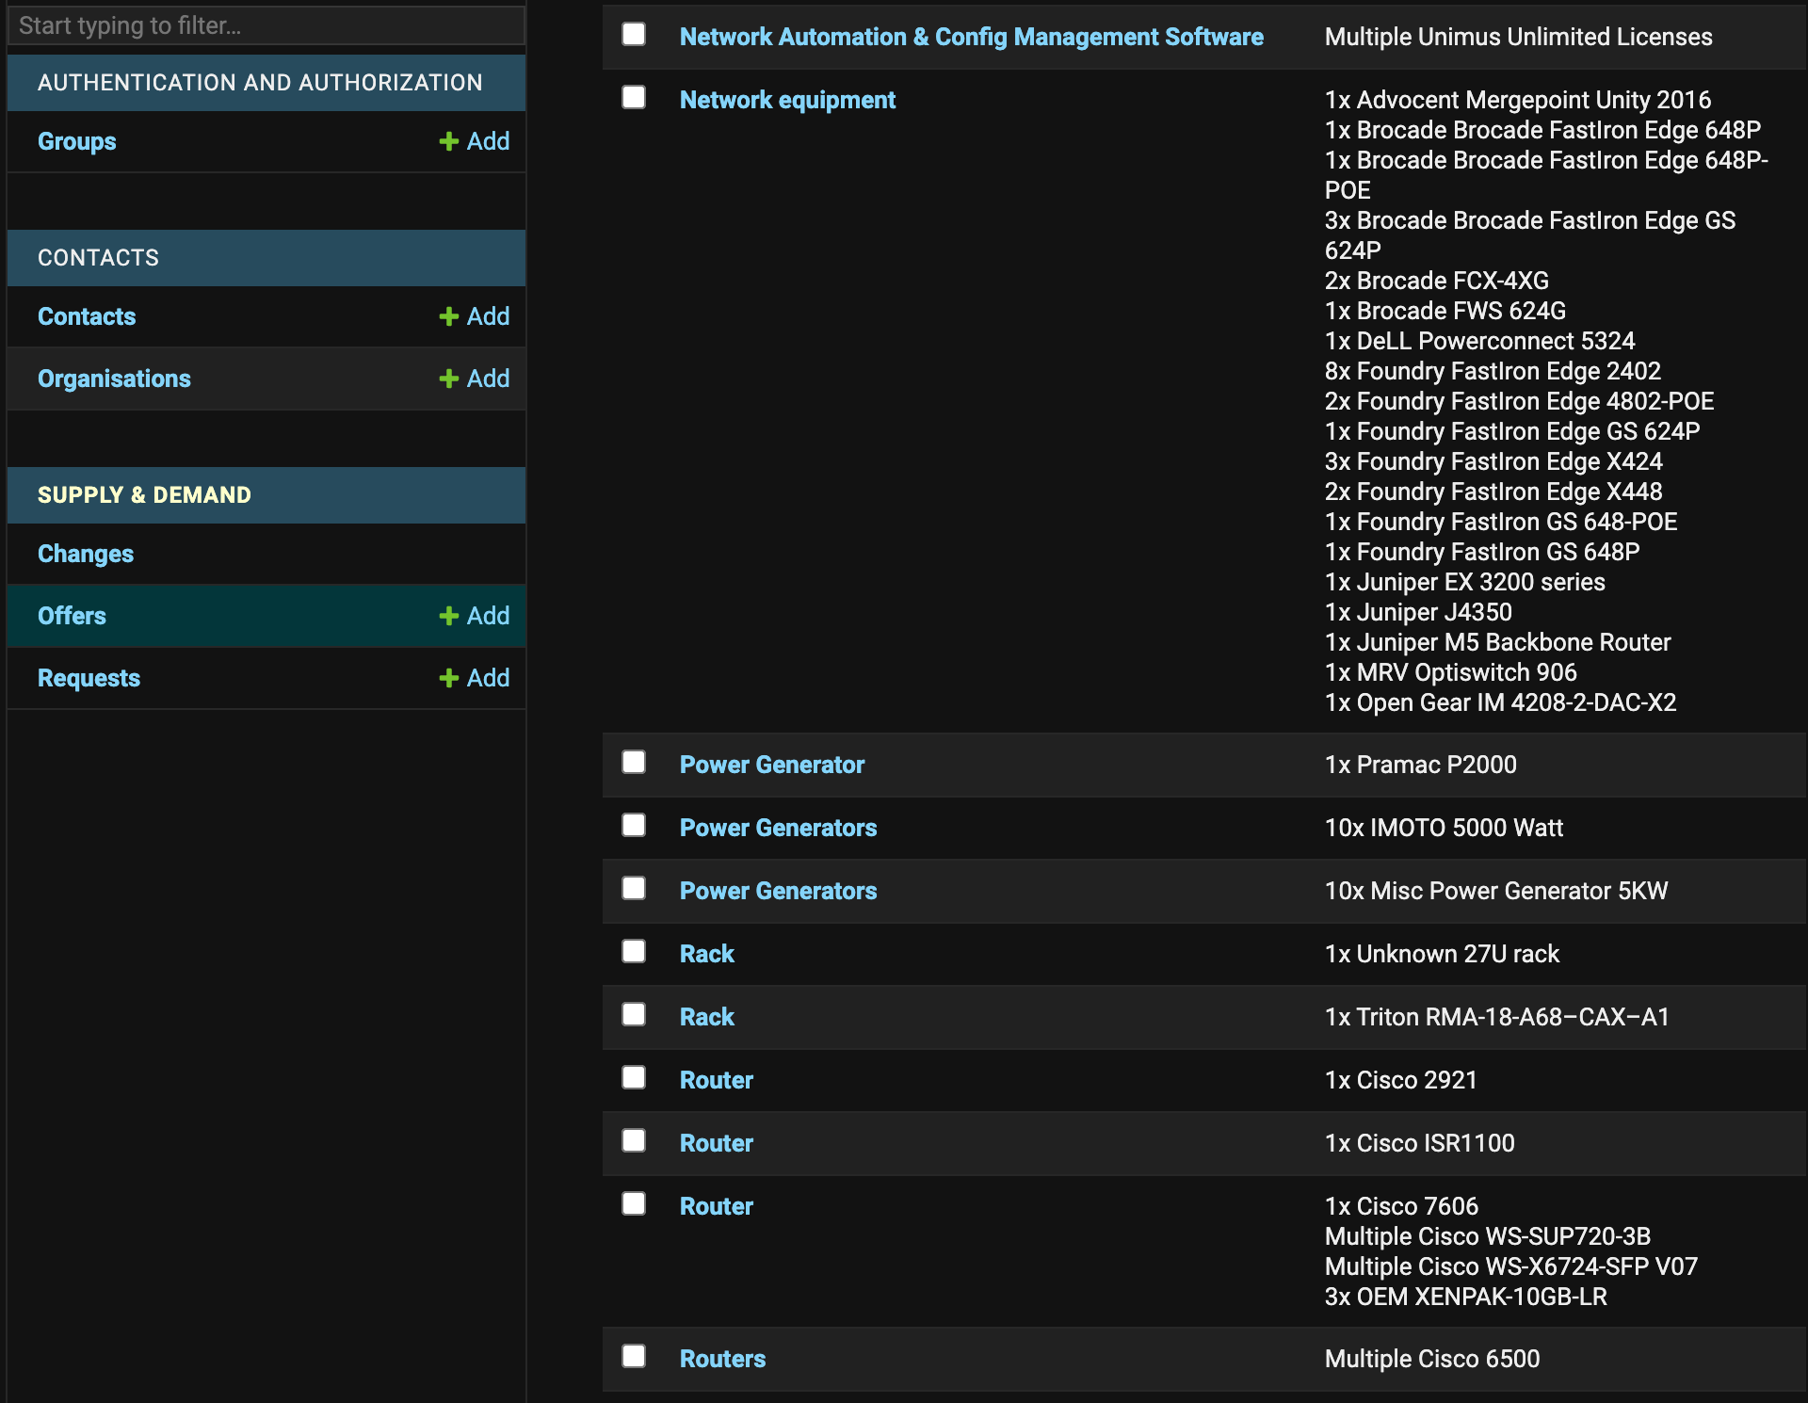
Supply & Demand Tool
v1.0

Slide 12
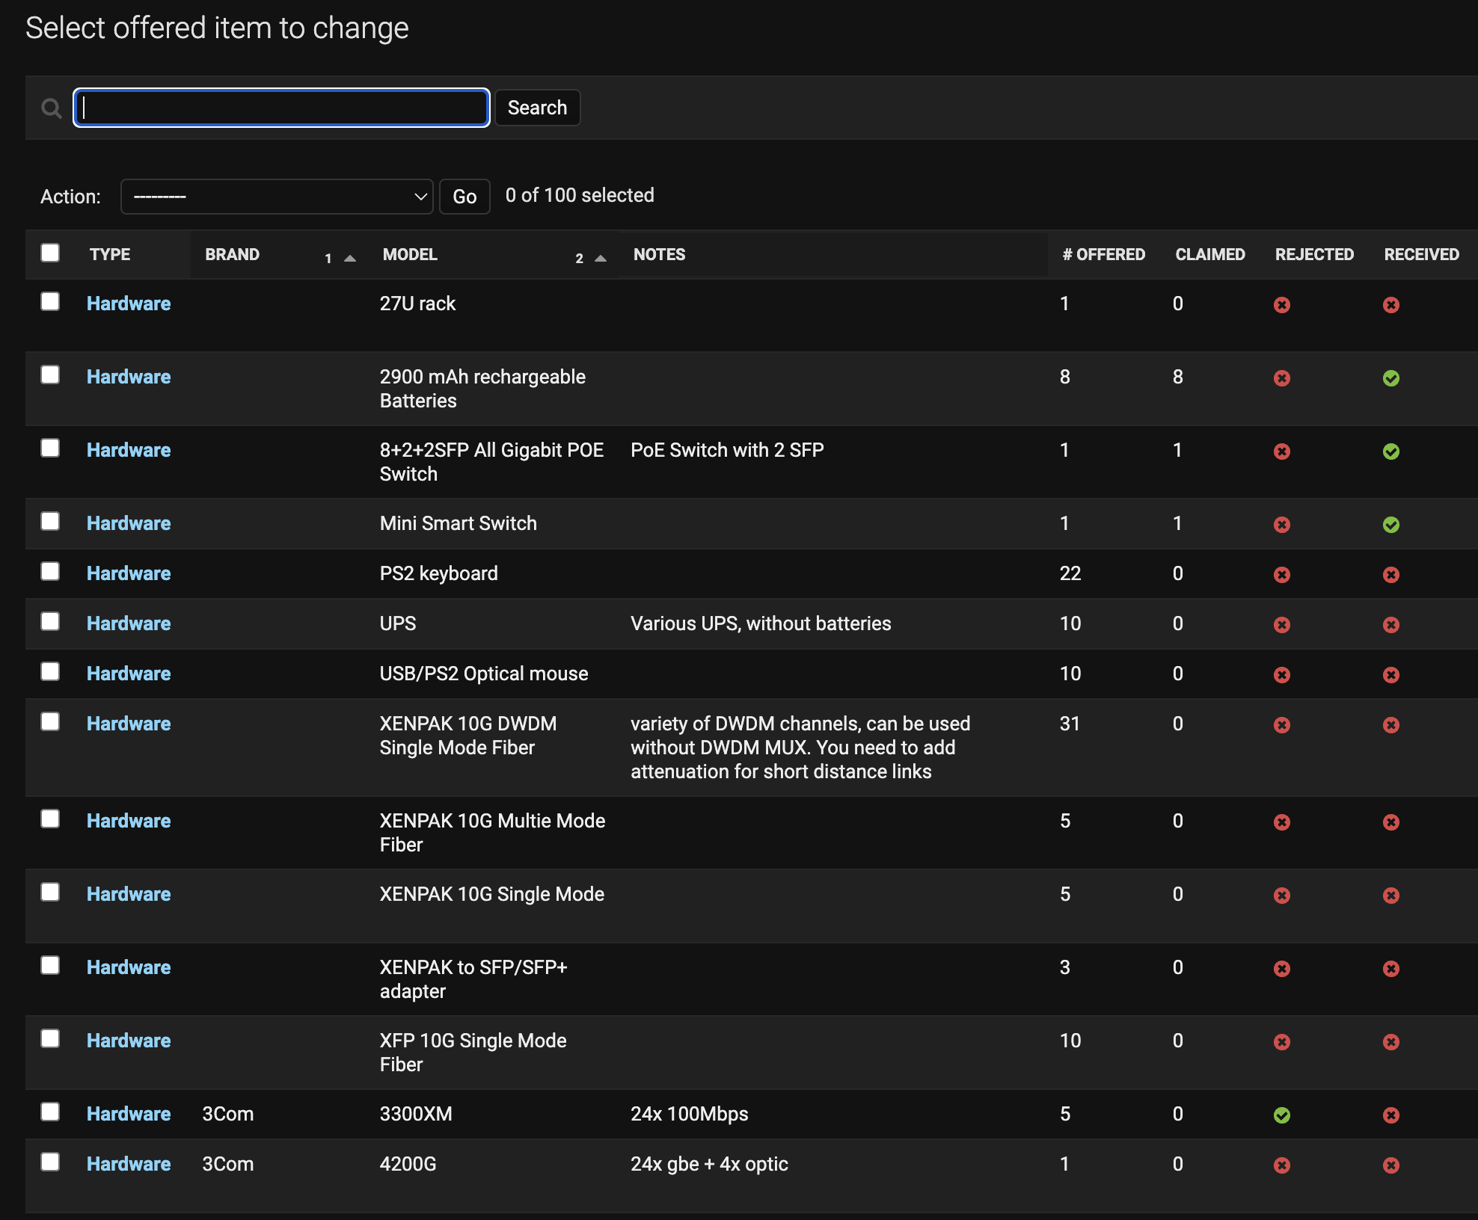
Supply & Demand Tool
(Donor View)
v2.0

Slide 13
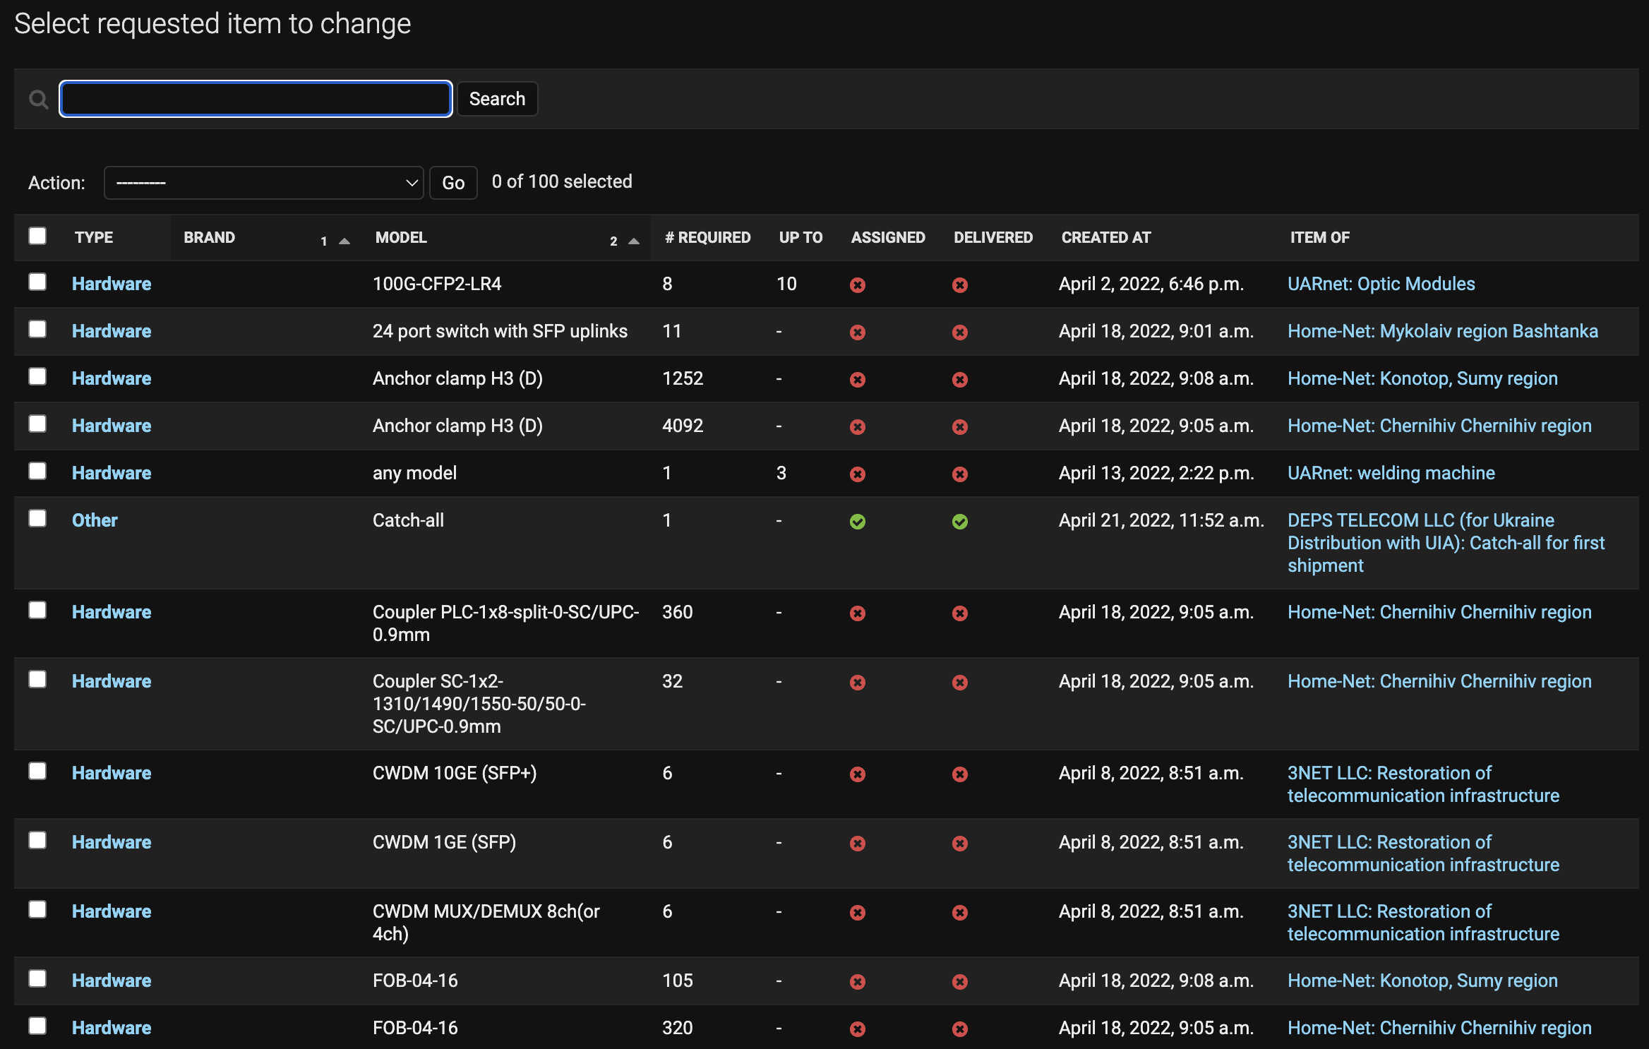
Supply & Demand Tool
(Requester View)
v2.0

Slide 14



Our Friends & Partners
in Ukraine
We are currently working with the organisations listed below. They are helping us with paperwork, permits, and local distribution of the donated equipment.
Ministry of Digital Transformation
DEPS
(local distribution)
Ukrainian Internet Association

Slide 15
…so why are we doing this?

Slide 16
Why is the internet important in Ukraine right now?
85% of Ukraine >15 years old had access to the Internet in January 2021

Slide 17
Encrypted communication has exploded since 24 February 2022
Telegram topped the charts with 54,200 new installs (+25%)
Bridgefy increased from 591 to 28,550 (+4,730%)
Zello grew downloads from 12,540 to 24,990 (+99,3%)
Signal grew downloads 20,6%
Source: https://techcrunch.com/2022/02/28/ukrainians-turn-to-encrypted-messengers-offline-maps-and-twitter-amid-russian-invasion/?guccounter=1

Slide 18
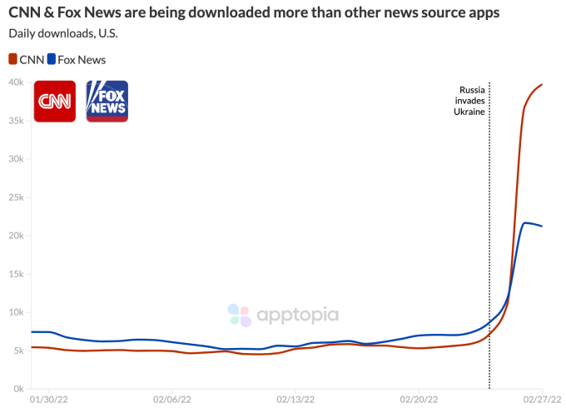
Accessing international news is reliant on the Internet
Source: https://techcrunch.com/2022/02/28/ukrainians-turn-to-encrypted-messengers-offline-maps-and-twitter-amid-russian-invasion/?guccounter=1

Slide 19
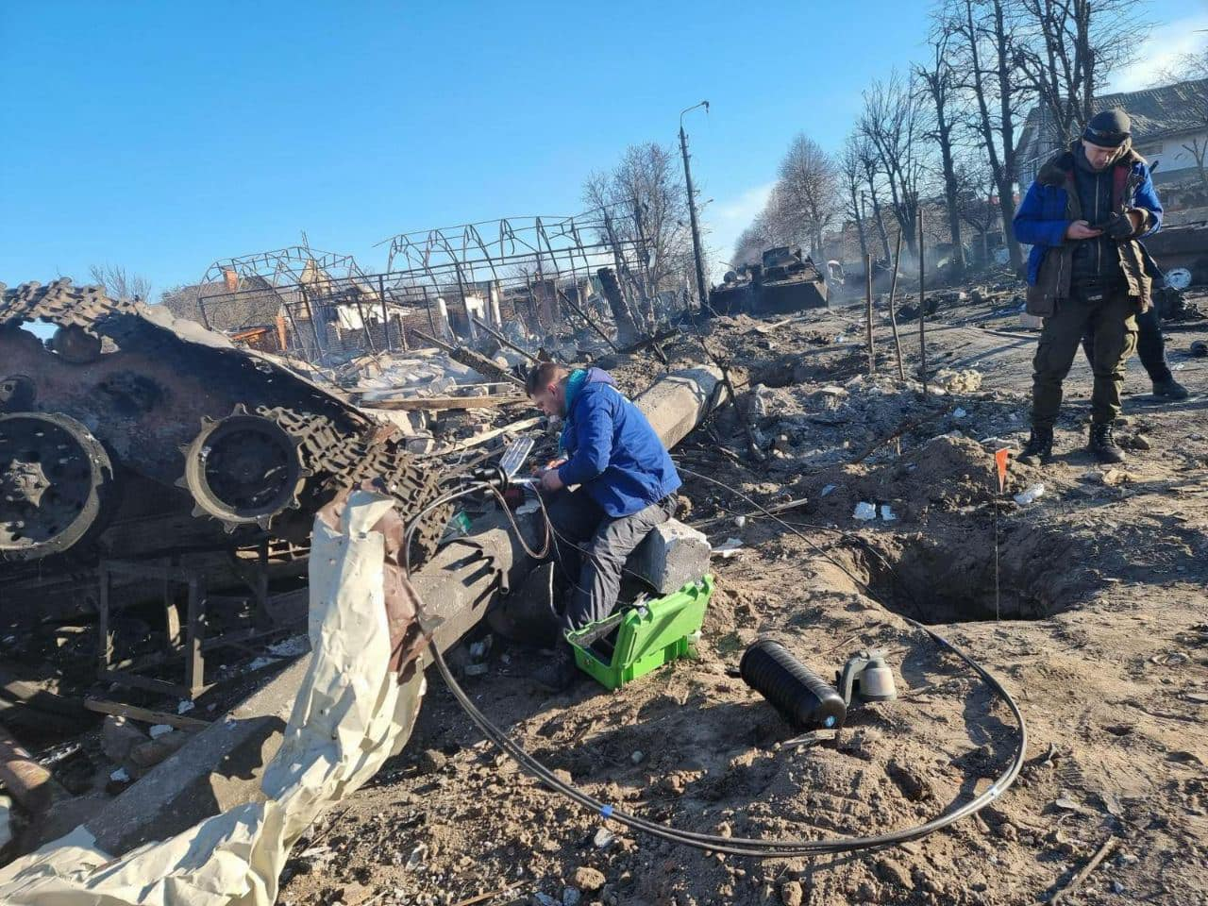

Slide 20
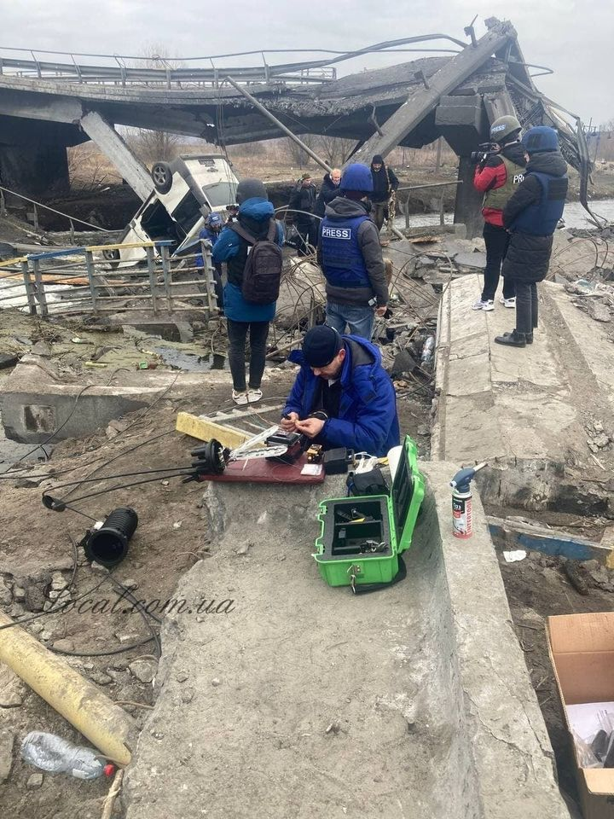

Slide 22
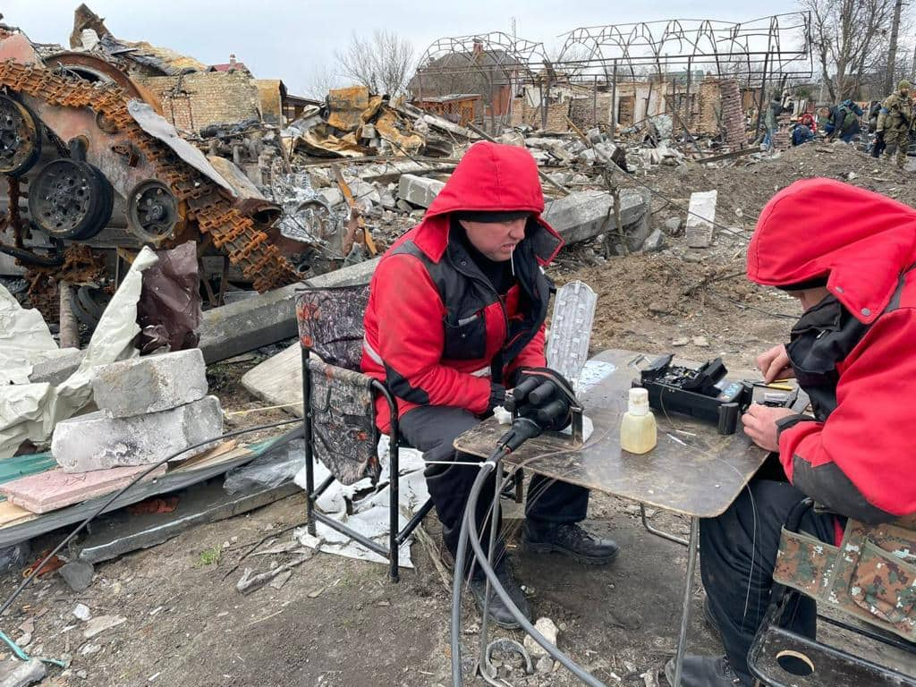

Slide 23
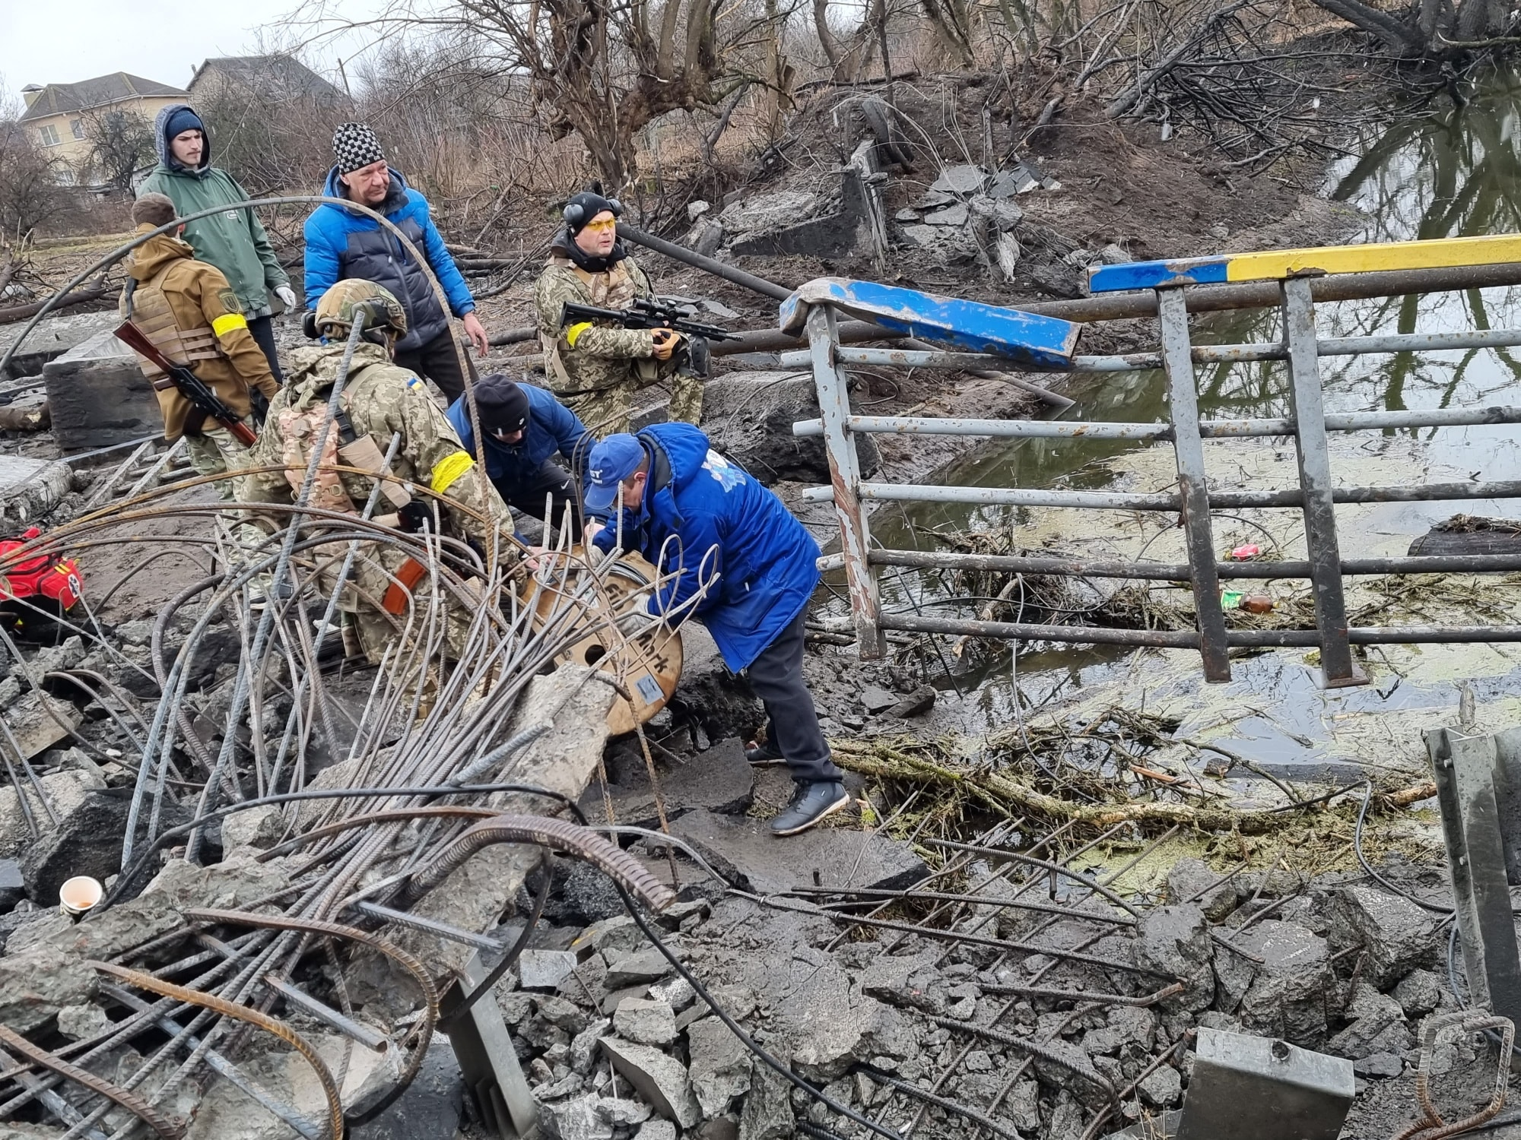

Slide 24
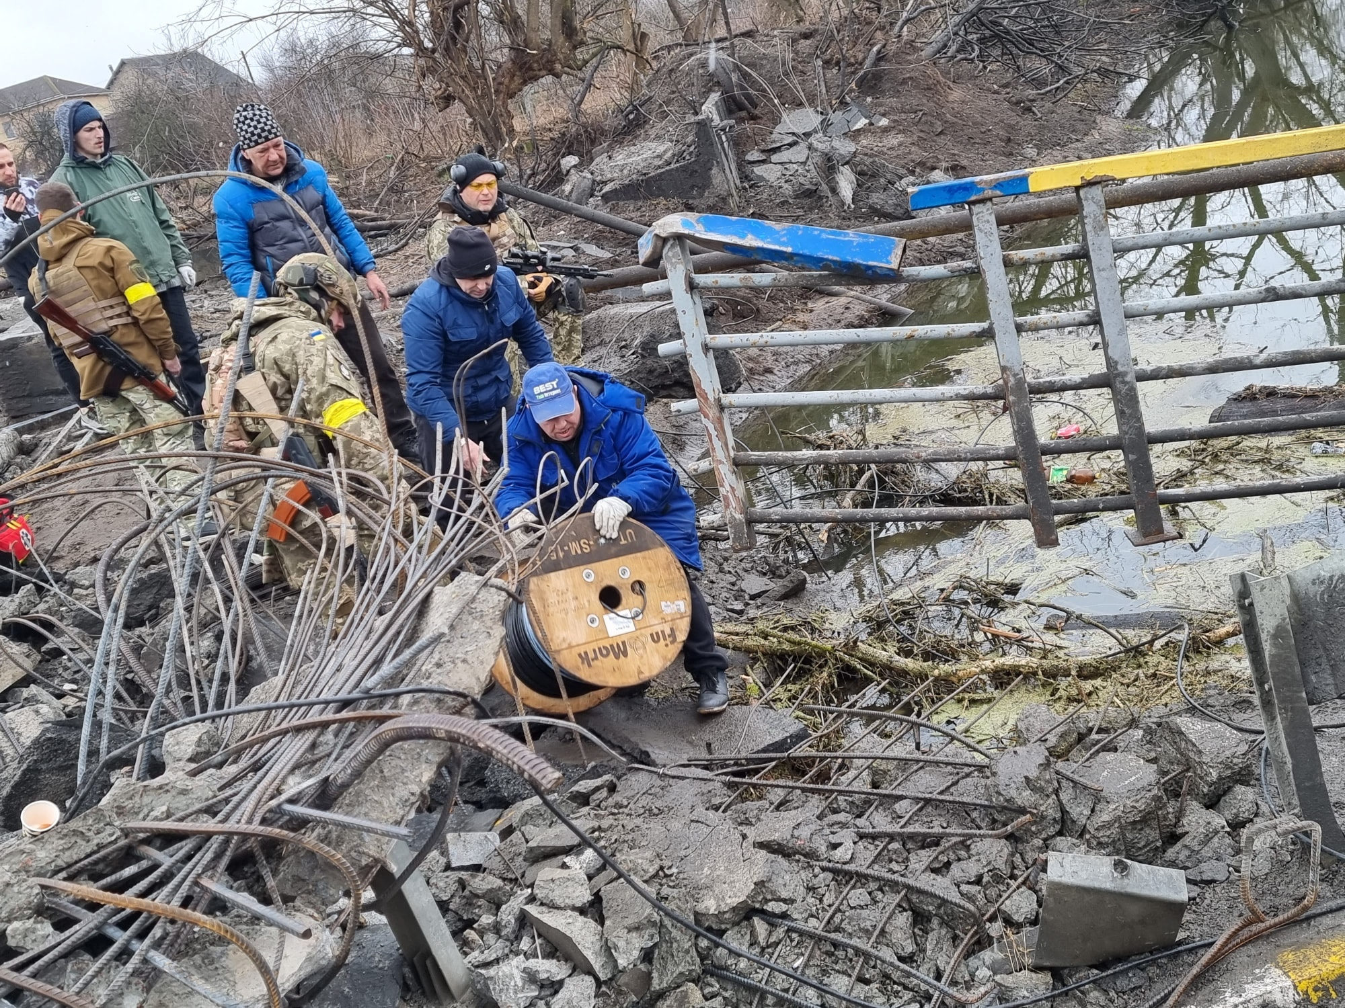

Slide 25
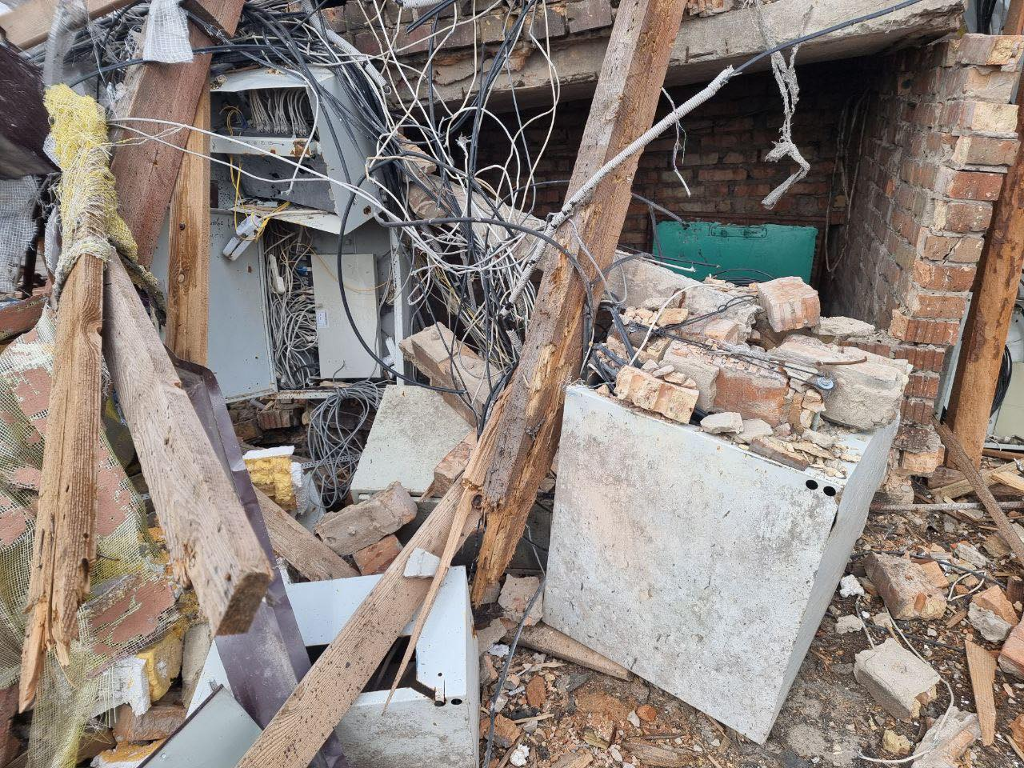

Slide 26
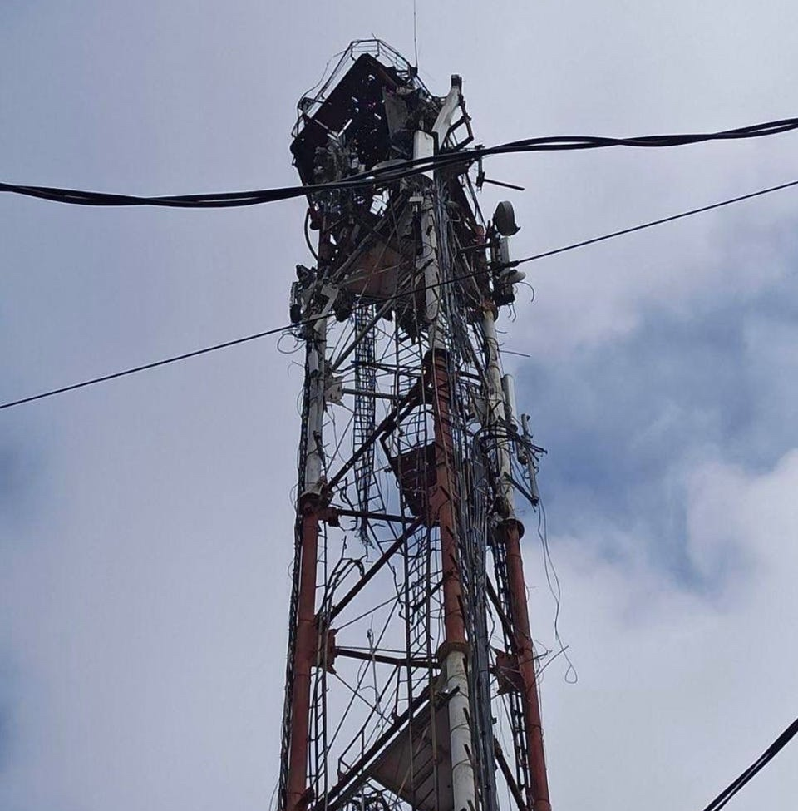
https://www.forbes.com/sites/thomasbrewster/2022/03/31/the-last-days-of-mariupols-internet/?sh=737996785962

Slide 27
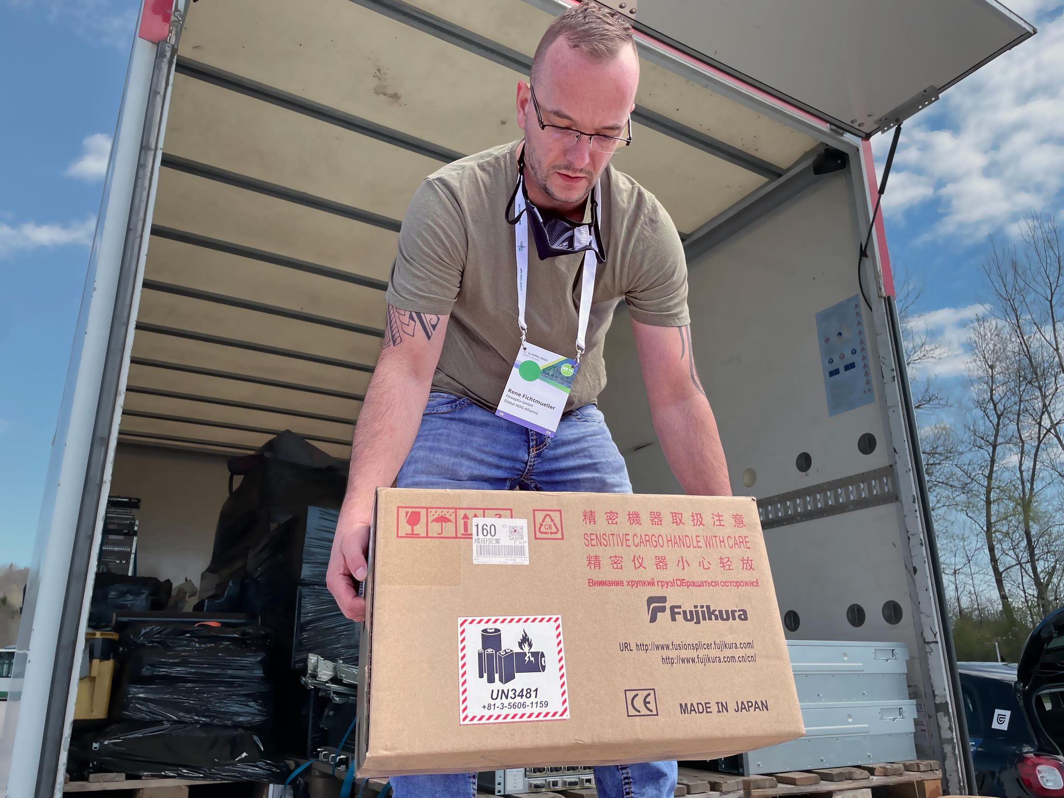
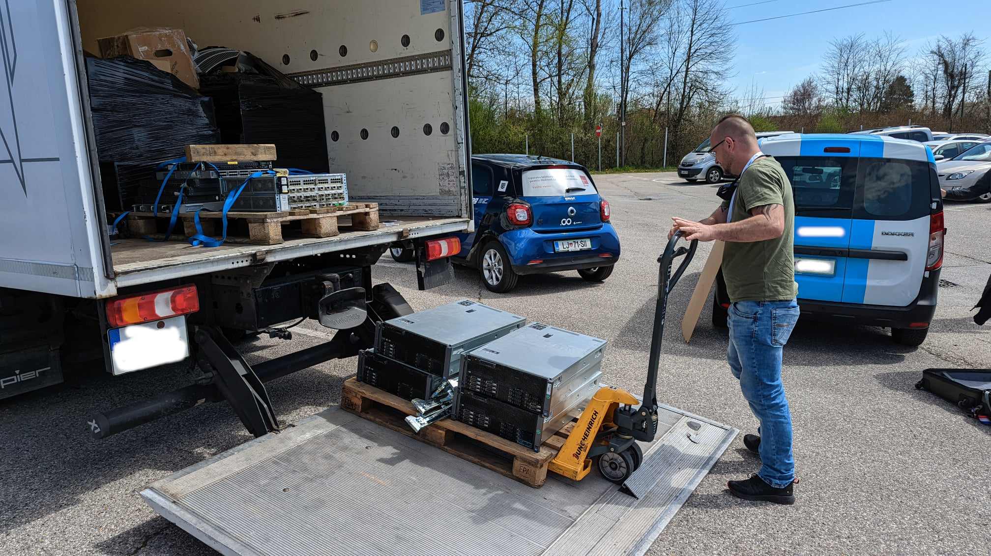
First run to Ukraine
Fully loaded with 14 pallets of equipment and a weight of around 2 tons
Loading a donated splicer!

Slide 28
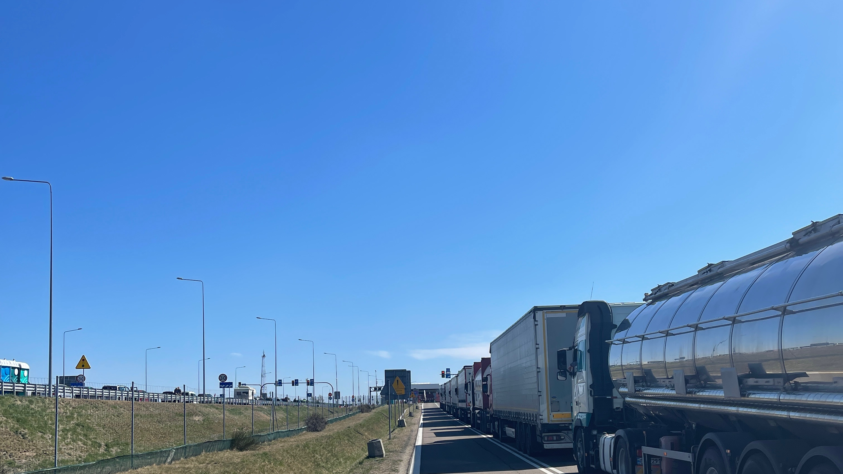
The customs queue….

Slide 29
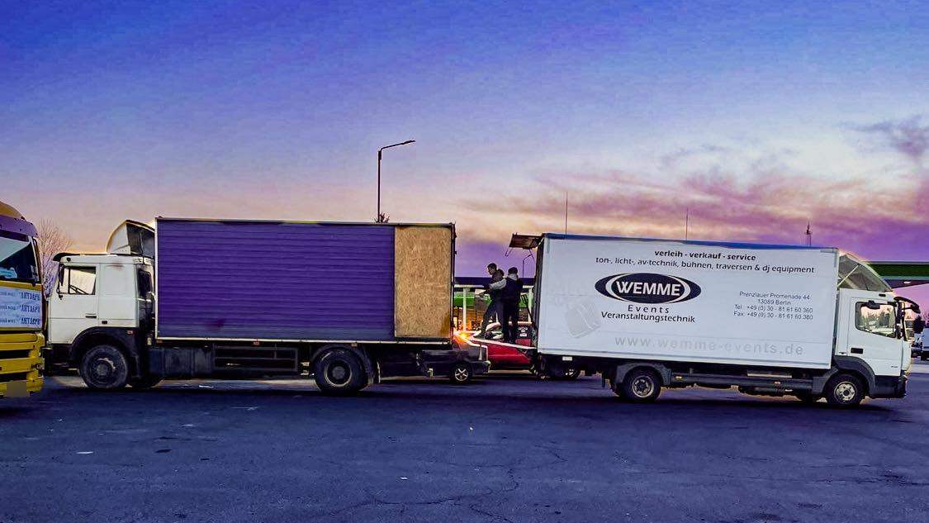
8 hours later…

Slide 30
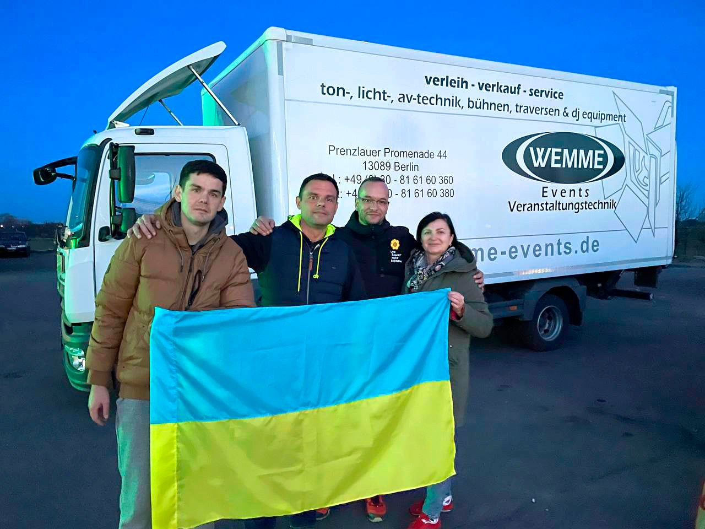
Done! The first of many.

Slide 31
What happens next?

Slide 32
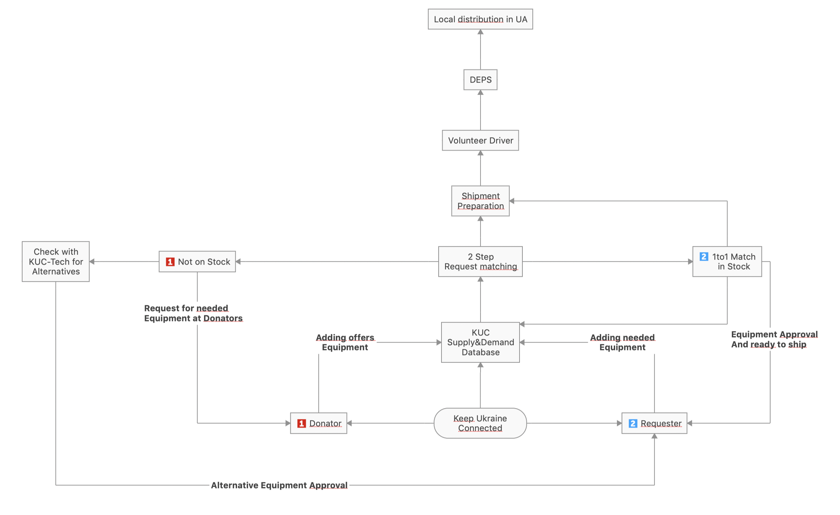
Working on the supply chain

Slide 33
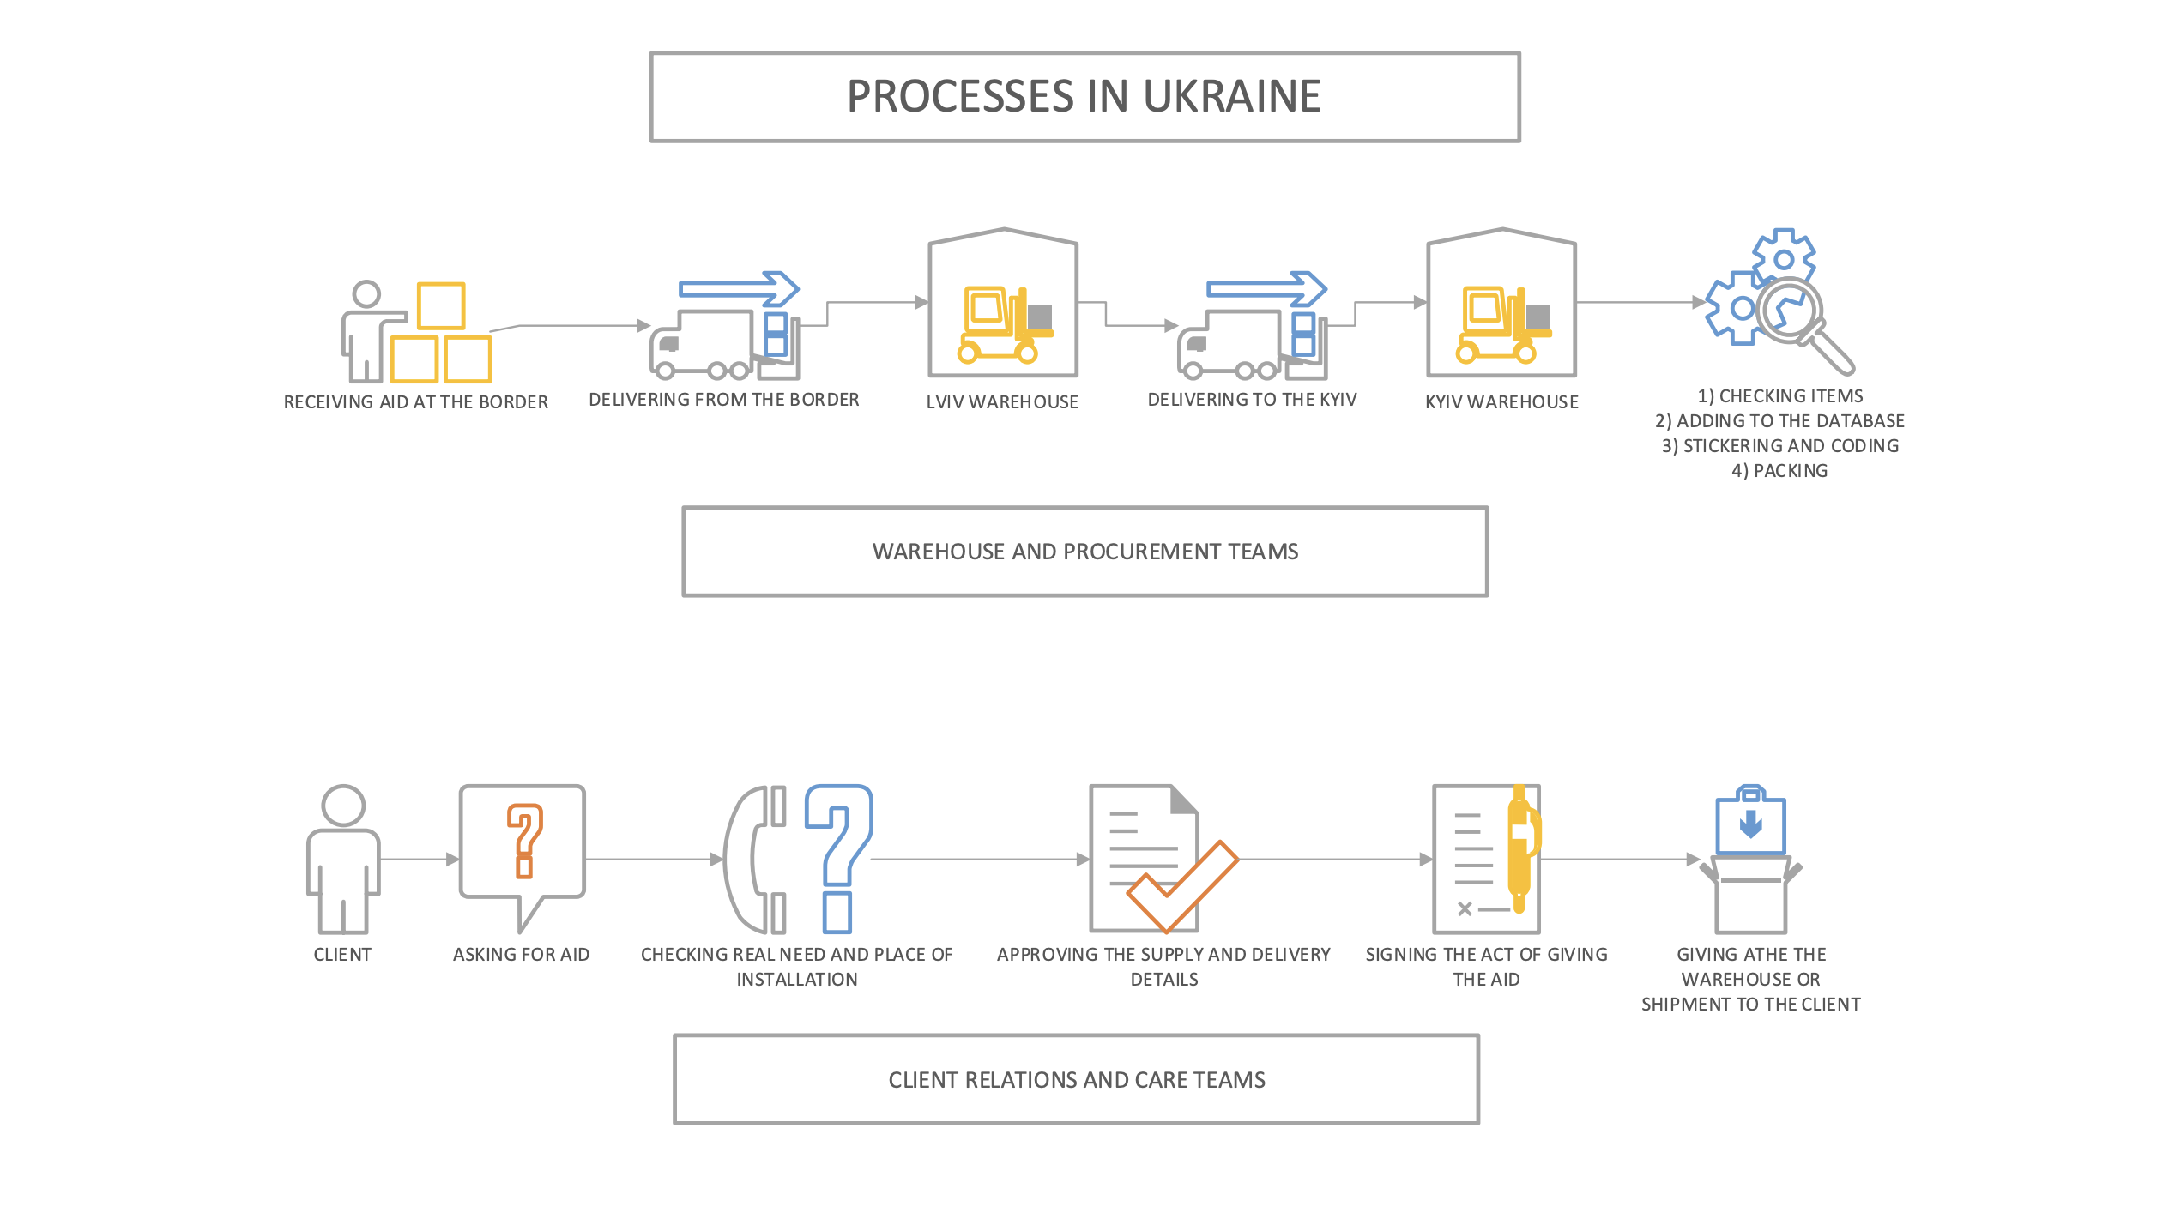
Working on the supply chain

Slide 34
Working on the supply chain

Slide 35
Continuing conversations with:
Donors
Partners
Governments
Poland, Ukraine, EU, customs and more.

Slide 36
And trying to fit in our real jobs and family too…

Slide 37
Who is behind the Task Force “Keep Ukraine Connected?

Slide 38
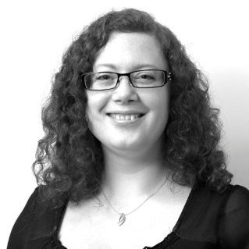
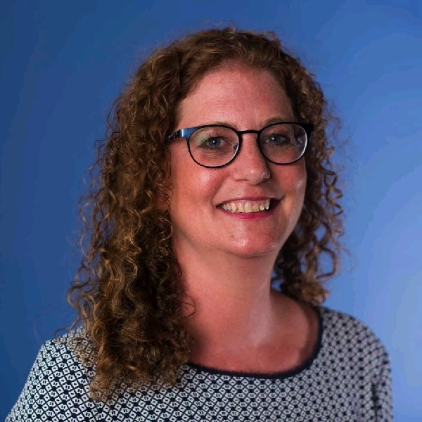
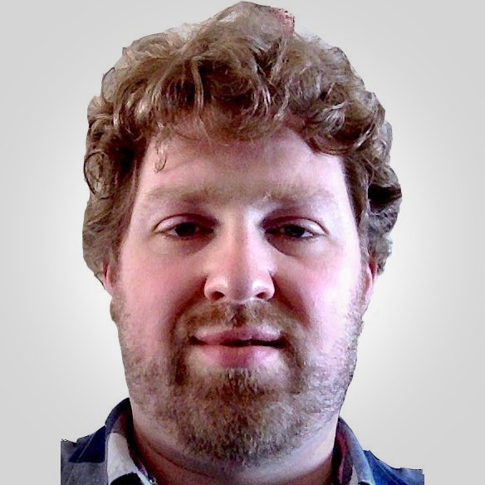
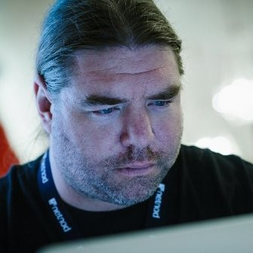
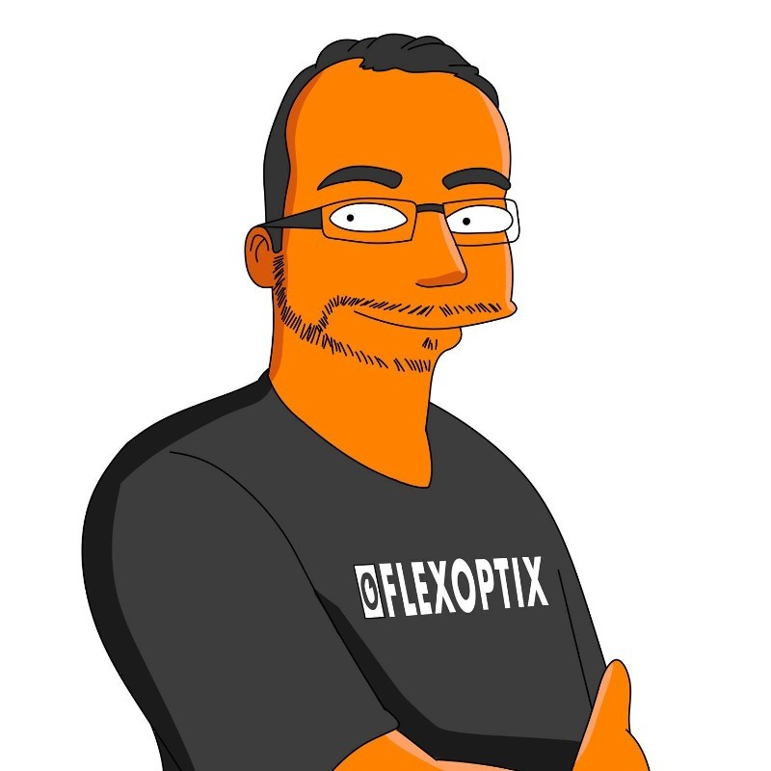
Who is behind the Task Force Keep Ukraine Connected?
Corinne Pritchard
Nathalie Trenaman
Sander Steffann
Jan Žorž
Rene Fichtmueller

Slide 39
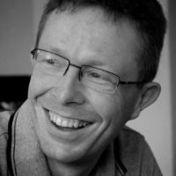
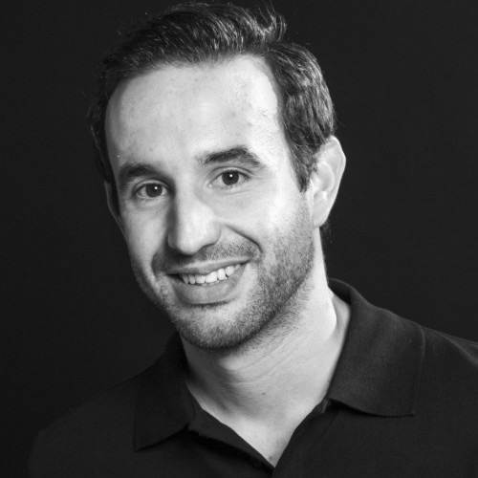
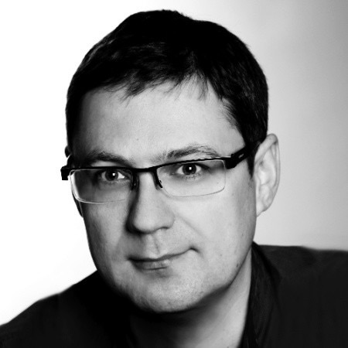
Who is behind the Task Force Keep Ukraine Connected?
Corinne Pritchard
Nathalie Trenaman
Sander Steffann
Jan Žorž
Rene Fichtmueller
Erik Bais
Daniel Houben
Marcin Kuczera

Slide 40
Thanks also goes to our wider KUC team…
Natalya Klitna (APPK)
Bogdana Piven (Regulatory Authority – NCEK)
Dmitry Knyazev and everyone at DEPS
Team at Ukraine Internet Association
Team @ Ukraine Minstry for Digital Transformation
Julia Troyan

Slide 41
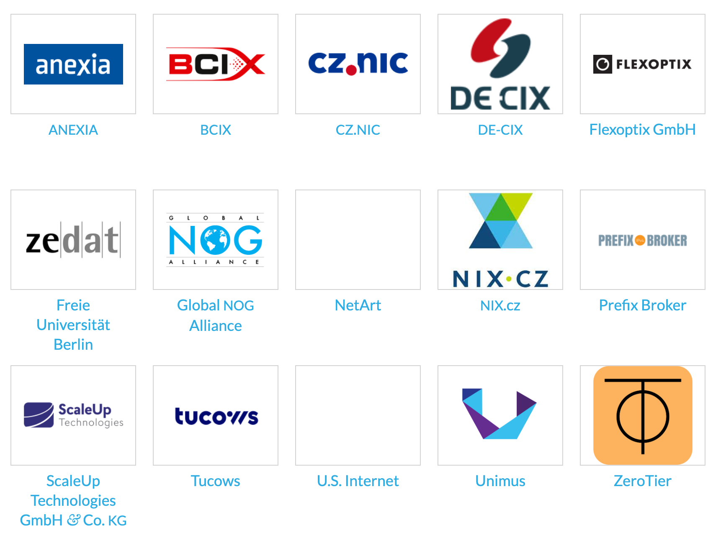
Big thanks to all of you that donated hardware and/or funds!
…and also to all of you who are considering helping in the future ☺

Slide 42
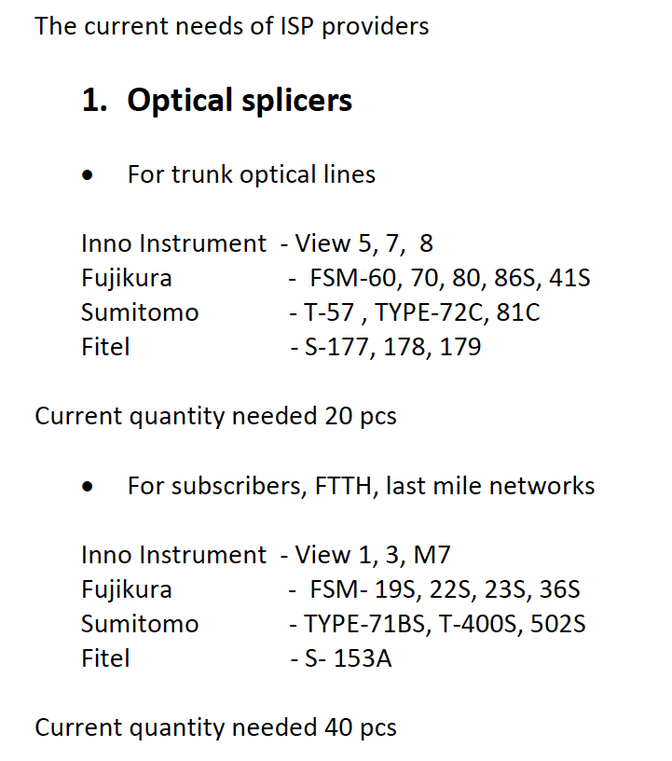
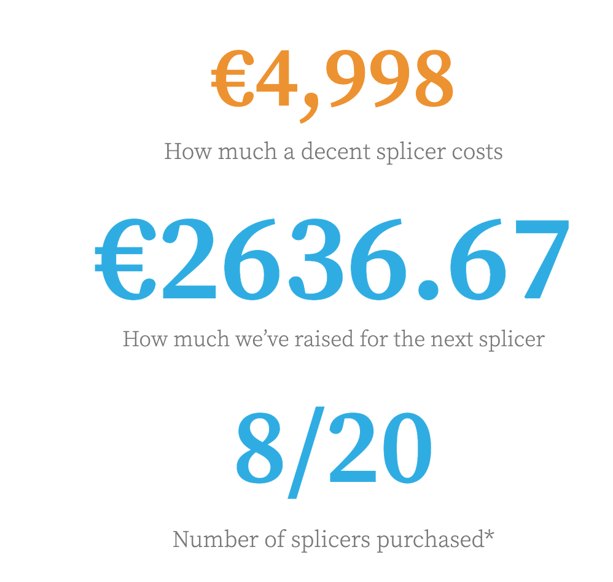

Help us get more splicers!
Fiber optic splicers are our most requested tool. We send them to areas where repairs are most needed. Please donate if you can.
keepukraineconnected.org > Splicer Fundraising

Slide 43
Thank you!
Mail us: ukraine@nogalliance.org

