Slide 1
#intro_gna
Rene Fichtmueller - Board Member- GNA 24.05.2019
#csnog2019

Slide 2
#created a global organisation with one mission: #help network operators & nog´s
Rene Fichtmueller - Board Member- GNA 24.05.2019
#csnog2019

Slide 3
#gna_board
Rene Fichtmueller - Board Member- GNA 24.05.2019
#csnog2019

Slide 4
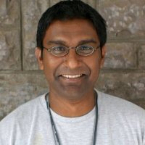
Nishal Goburdhan (ZA) #chair a internet infastructure analyst, specialist in internet infrastructure, ixp Manager and supporter of nogs
Rene Fichtmueller - Board Member- GNA 24.05.2019
#csnog2019

Slide 5
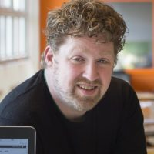
Sander Steffann (NL) #treasurer_&_secretary an international IPv6 consultant and founder member of nlnog, former ripe address policy working group co‐chair
Rene Fichtmueller - Board Member- GNA 24.05.2019
#csnog2019

Slide 6
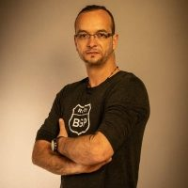
Rene Fichtmueller (GE) #board_member an optician aspirant with ixp background, very well known as an international participant and supporter of nogs, and one of the founding members of djsintech
Rene Fichtmueller - Board Member- GNA 24.05.2019
#csnog2019

Slide 7
#what _we_are_doing: #supporting nogs around the world #providing tools #help network operators develop their local community #mentoring
Rene Fichtmueller - Board Member- GNA 24.05.2019
#csnog2019

Slide 8
#how_we_are_doing_it: #mentoring #bringing together network operators #operate and customize gna_tools #give nogs a head start and help them to thrive and grow
Rene Fichtmueller - Board Member- GNA 24.05.2019
#csnog2019

Slide 9
#encouraging world-wide cooperation #building a global community hub #speaker database #organising best practice workshops for new nogs
Rene Fichtmueller - Board Member- GNA 24.05.2019
#csnog2019

Slide 10
#gna_tools: #website (wordpress) #cfa & #cfp #registration #video call system #onsite tools #badge printing #speaker survey #event survey #speaker database
Rene Fichtmueller - Board Member- GNA 24.05.2019
#csnog2019

Slide 11
#cfa and #cfp: #call for abstract #call for presentation #backend incl. rating/ Judging #timetable #speaker survey
Rene Fichtmueller - Board Member- GNA 24.05.2019
#csnog2019

Slide 12
#agenda_and_timeshedule: #timetable #agenda scheduling
Rene Fichtmueller - Board Member- GNA 24.05.2019
#csnog2019

Slide 13
#event_registration: #online-registration #payment (paypal, cc, invoice) #attendee management; roles; and rules #attendee list publishing online
Rene Fichtmueller - Board Member- GNA 24.05.2019
#csnog2019

Slide 14
#onsite_management: #onsite check-in #mobile check-in #badge printing
Rene Fichtmueller - Board Member- GNA 24.05.2019
#csnog2019

Slide 15
#survey: #speaker survey live #event survey
Rene Fichtmueller - Board Member- GNA 24.05.2019
#csnog2019

Slide 16
#video_conf_call_System: #nog rooms #commitee rooms
Rene Fichtmueller - Board Member- GNA 24.05.2019
#csnog2019

Slide 17
#website_cms_system: #sso to all gna tools
Rene Fichtmueller - Board Member- GNA 24.05.2019
#csnog2019

Slide 18
#nog_cloud: #nog cloud #250GB
Rene Fichtmueller - Board Member- GNA 24.05.2019
#csnog2019

Slide 19
#nog_mailinglist: #gdfpr compliant
Rene Fichtmueller - Board Member- GNA 24.05.2019
#csnog2019

Slide 20
#longterm_plan: #cover speaker expenses for nogs to getting better speaker #fund open source projects that benefit network operators #provide nogs with training material they can use for their members
Rene Fichtmueller - Board Member- GNA 24.05.2019
#csnog2019

Slide 21
#creating regional working groups #speaker database #event database (nsrc calendar)
Rene Fichtmueller - Board Member- GNA 24.05.2019
#csnog2019

Slide 22
#we_need_you #how_you_can_help: #input #topics #projects #speakers #open source development #motivation and_money (sponsoring)
Rene Fichtmueller - Board Member- GNA 24.05.2019
#csnog2019

Slide 23
board@nogalliance.org
Rene Fichtmueller - Board Member- GNA 24.05.2019
#csnog2019

