Slide 1
Automated network OS
testing
Tomáš Kubina / Orange Business Services
tomas.kubina@orange.com

Slide 2
Automated network OS testing
Network OS testing at OBS
Orange Business Services (OBS) – worldwide telecommunications operator and service provider for enterprise market
main features of network: L3VPN, L2VPN, BGP, ISIS, MPLS, MPLS/TE, QoS, LAC, IPv6, LDP, etc…
3 labs with real and virtual devices simulating our network
3 locations and around 35 people working on tests and development
usual test of network feature: prepare and check testbed, put configuration of feature, check state of device and feature, do some bad things if needed, check stability and finish
70% of checks and 30% of configuration

Slide 3
Automated network OS testing
Testing challenges
increase of complexity of network and network OSes in order to provide more and more features to customers
many recurring tests (small/mid complexity)
isolation of human error / overlook
people need to focus on development of new features rather than testing of old ones
reduce time to test network OS before deployment on live network
=> WE SHOULD AUTOMATE

Slide 4
Automated network OS testing
Key factors of automation in OBS
verification of operational state is key
YANG models for operational state are still heavily evolving => not all monitored attributes covered, available only in newer OS releases / router platforms
Netmiko – simple management of device via ssh, push command / get output
NAPALM has support for configuration and operational state :
CISCO IOS/IOS-XE - screen scrapping and parsing
Juniper JunOS – processing of xml reply received over NETCONF
Ansible – focus on provisioning and controlling
- Junos PyEZ – configuration + operational state for JunOS only
NAPALM is the winner, because…

Slide 5
Automated network OS testing
NAPALM
open source project
implements a set of functions using a unified API to different router vendor network devices (ios, ios-xr, junos, nx-os,…)
replacing/merging/comparing of configuration
rollback of configuration
retrieving operational data (interfaces’ ip/state, BGP neighbors details, cpu, memory,…)
can be integrated in ansible, SaltStack

Slide 6
Automated network OS testing
OBS NAPALM extension
functions to provide operational data for IS-IS, LDP, BFD, BGP, PIM, MPLS TE, …
created for ios-xe and junos
tested on CISCO ASR1K, CISCO 76xx, Juniper MX480
some functions are specific to one vendor or are platform specific
unification of various output
new code will be published as official napalm code or standalone extension, point to discuss with NAPALM maintainer

Slide 7
Automated network OS testing
functions added for Juniper platform:
get_redundancy_info
get_card_type_info
get_mx_re_memory_info
get_mx_active_re_memory_info
get_isis_neighbors_detail
get_isis_topology
get_bfd_neighbors_detail
get_ldp_igp_sync
get_ldp_neighbors
get_pim_neighbors(_vrf)
get_pim_joins(_vrf)
get_multicast_route(_vrf)
get_mvpn_info
get_l2ckt_connections
get_vpls_connections
get_interfaces_rates
get_route_summary(_vrf)
get_fib_table(_vrf)

Slide 8
Automated network OS testing
functions added for CISCO platform:
get_redundancy_info
get_card_type_info
get_asr1k_slot_memory_info
get_isis_neighbors_detail
get_isis_topology
get_bfd_neighbors_detail
get_ldp_igp_sync
get_ldp_neighbors
get_mpls_l2transport_summary
get_mpls_te_tunnels_brief
get_ip_route_summary(_vrf)
get_ip_cef(_vrf)
get_interfaces_rates
get_xconnect_all
get_bgp_all_summary
get_pim_neighbors(_vrf)
get_ip_mroute(_vrf)
get_ip_mfib (_vrf)
get_ip_mfib_active(_vrf)
get_vrf
get_bgp_vpnv4_vrf

Slide 9
Automated network OS testing
NAPALM example
Test name: Reload Test
Test description: Connect to router, get global operational state of router, execute full reload, connect after 30minutes, get global operational state again and compare with outputs with state gathered before reload
Pass criteria: Operational state before and after reload of device must be same, with some tolerance (memory, dynamic virtual interfaces name, routing protocol peers uptime,…)

Slide 10
Automated network OS testing
CISCO CLI:
Bnet-A1#sh isis neighbors detail
System Id Type Interface IP Address State Holdtime Circuit Id
Bnet-P1 L2 Gi3/0/17 192.168.244.189 UP 29 00
Area Address(es): 65.0421
SNPA: e4c7.2259.96c5
State Changed: 1d01h
Format: Phase V
Remote TID: 0
Local TID: 0
Interface name: GigabitEthernet3/0/17
Neighbor Circuit Id: 78
BFD enabled: (MTID:0, ipv4)
Bnet-P1 L2 Gi3/0/8.1308 192.168.244.109 UP 23 00
Area Address(es): 65.0421
SNPA: e4c7.2259.96b4
State Changed: 1d01h
Format: Phase V
Remote TID: 0
Local TID: 0
Interface name: GigabitEthernet3/0/8.1308
Neighbor Circuit Id: 116
Remote BFD Support: (MTID:0, IPV4)
System Id Type Interface IP Address State Holdtime Circuit Id
BFD enabled: (MTID:0, ipv4)
Bnet-A1#

Slide 11
Automated network OS testing
output from get_isis_neighbors from cisco platform:
'Bnet-P1': {u'Te3/1/0.1622': {u'area': u'65.0421',
u'bfd_enabled': u'(MTID:0, ipv4)',
u'circuit_id': u'00',
u'format': u'Phase V',
u'holdtime': u'24', ⬅=================== can be different after reload
u'ip_address': u'192.168.244.250',
u'level': u'L2',
u'local_tid': u'0',
u'remote_bfd_support': u'(MTID:0, IPV4)',
u'remote_tid': u'0',
u'snpa': u'e4c7.225b.8d2f',
u'state': u'UP',
u'state_changed': 80892}, ⬅=================== can be different after reload
u'Te3/1/1': {u'area': u'65.0421',
u'bfd_enabled': u'(MTID:0, ipv4)',
u'circuit_id': u'00',
u'format': u'Phase V',
u'holdtime': u'28', ⬅=================== can be different after reload
u'ip_address': u'192.168.244.50',
u'level': u'L2',
u'local_tid': u'0',
u'remote_bfd_support': u'(MTID:0, IPV4)',
u'remote_tid': u'0',
u'snpa': u'70e4.2219.9f8f',
u'state': u'UP',
u'state_changed': 80895}}} ⬅=================== can be different after reload

Slide 12
Automated network OS testing
output from get_asr1k_slot_memory_info from cisco platform:
'0': {u'state': u'ok', u'type': u'ASR1000-SIP40'},
'0/0': {u'state': u'ok', u'type': u'SPA-5X1GE-V2'},
'0/1': {u'state': u'ok', u'type': u'SPA-5X1GE-V2'},
'0/2': {u'state': u'ok', u'type': u'SPA-4XT3/E3-V2'},
'0/3': {u'state': u'ok', u'type': u'SPA-4X1FE-TX-V2'}
output from get_environment from cisco platform:
u'cpu': {0: {u'%usage': 11.0}},
u'fans': {u'invalid': {u'status': True}},
u'memory': {u'available_ram': 8619809248, u'used_ram': 1632733416}, ⬅====== +/- 5% tolerance
u'power': {u'invalid': {u'capacity': -1.0, u'output': -1.0, u'status': True}},
u'temperature': {u'invalid': {u'is_alert': False,
u'is_critical': False,
u'temperature': -1.0}}

Slide 13
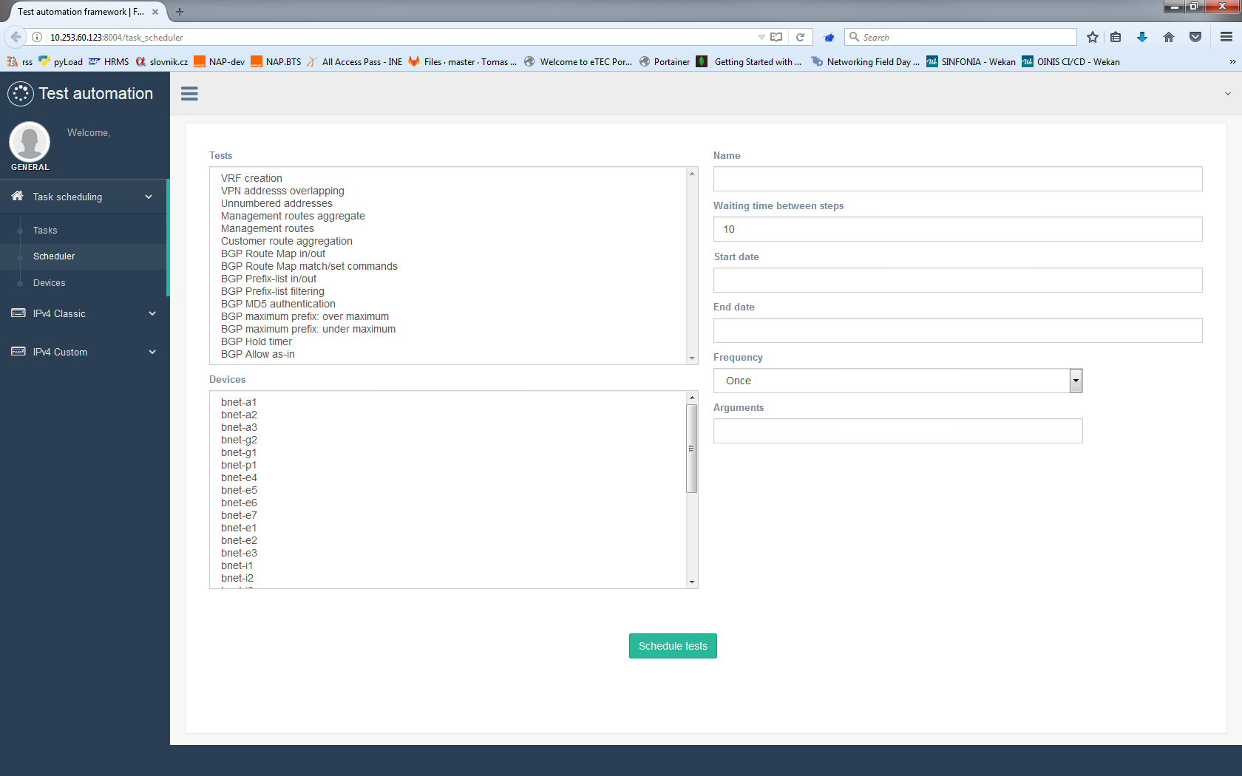
Automated network OS testing

Slide 14
Automated network OS testing
Evolution?
Robot Framework = generic open source automation framework for acceptance testing, acceptance test driven development and process automation
high-level “keywords” instructs what to do, usually have input arguments and output value
built- in keywords
custom keywords directly in test suite or in external library (Python or Java)
final test report generated in html
easy integration into CI/CD

Slide 15
Automated network OS testing
Robot Framework test example - file csnog-demo.robot
*** Settings ***
Documentation Demo script for CSNOG 2019:
... - Requiremtns: NAPALM (pip install napalm)
... - Please update SUT parameters
Library OBSRobotNapalm.OBSRobotNapalm
Test setup Connect device
*** Variables ***
${SUT}= 192.168.243.69
${LOGIN}= auto_test_user
${PASSWORD}= auto_test_user_password
*** Keywords ***
Connect device
${napalm-connection-SUT}= Napalm Connect ${SUT} ${LOGIN} ${PASSWORD}
Set Suite Variable ${napalm-connection-SUT}
< built-in keywords custom keywords from OBSNapalmRobot library >

Slide 16
Automated network OS testing
Robot Framework test description example
*** Test cases ***
TEST ISIS PEER FLAP
[Documentation] Check if ISIS peer is UP, clear ISIS process, check again
${isis_peer_ip}= Set Variable 192.168.245.89
${command}= Set Variable clear isis *
${peer_state}= Get ISIS Peer State ${napalm-connection-SUT} ${isis_peer_ip}
Should Be Equal UP ${peer_state}
Execute Operational Command ${napalm-connection-SUT} ${command}
Sleep 100
${peer_state}= Get ISIS Peer State ${napalm-connection-SUT} ${isis_peer_ip}
Should Be Equal UP ${peer_state}
TEST BGP PEER FLAP
<another test case>
< built-in keywords custom keywords from OBSNapalmRobot library >

Slide 17
Automated network OS testing
Robot Framework CLI output
(venv) tkubina@nap-dev:~/python/obs-eval-library$ robot csnog-demo.robot
==============================================================================
Csnog-Demo :: Demo script for CSNOG 2019:
==============================================================================
TEST ISIS PEER FLAP :: Check if ISIS peer is UP, clear ISIS proces... | PASS |
------------------------------------------------------------------------------
Csnog-Demo :: Demo script for CSNOG 2019: | PASS |
1 critical test, 1 passed, 0 failed
1 test total, 1 passed, 0 failed
==============================================================================
Output: /home/tkubina/python/obs-eval-library/output.xml
Log: /home/tkubina/python/obs-eval-library/log.html
Report: /home/tkubina/python/obs-eval-library/report.html
(venv) tkubina@nap-dev:~/python/obs-eval-library$

Slide 18
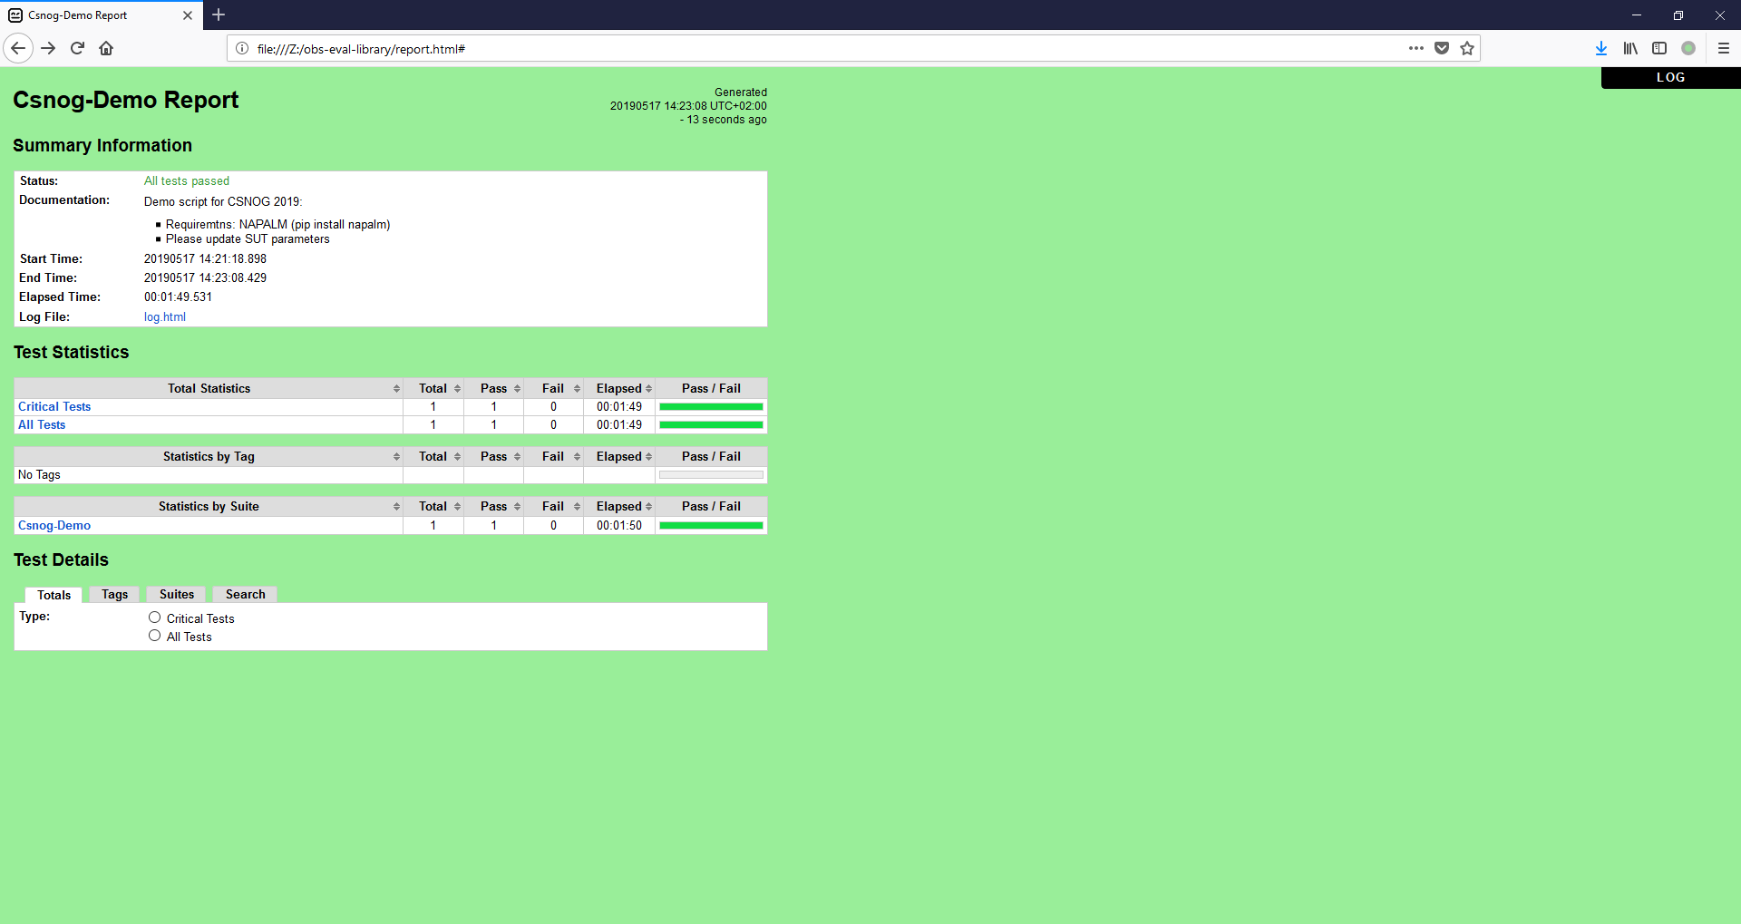
Automated network OS testing
Robot Framework html report

Slide 19
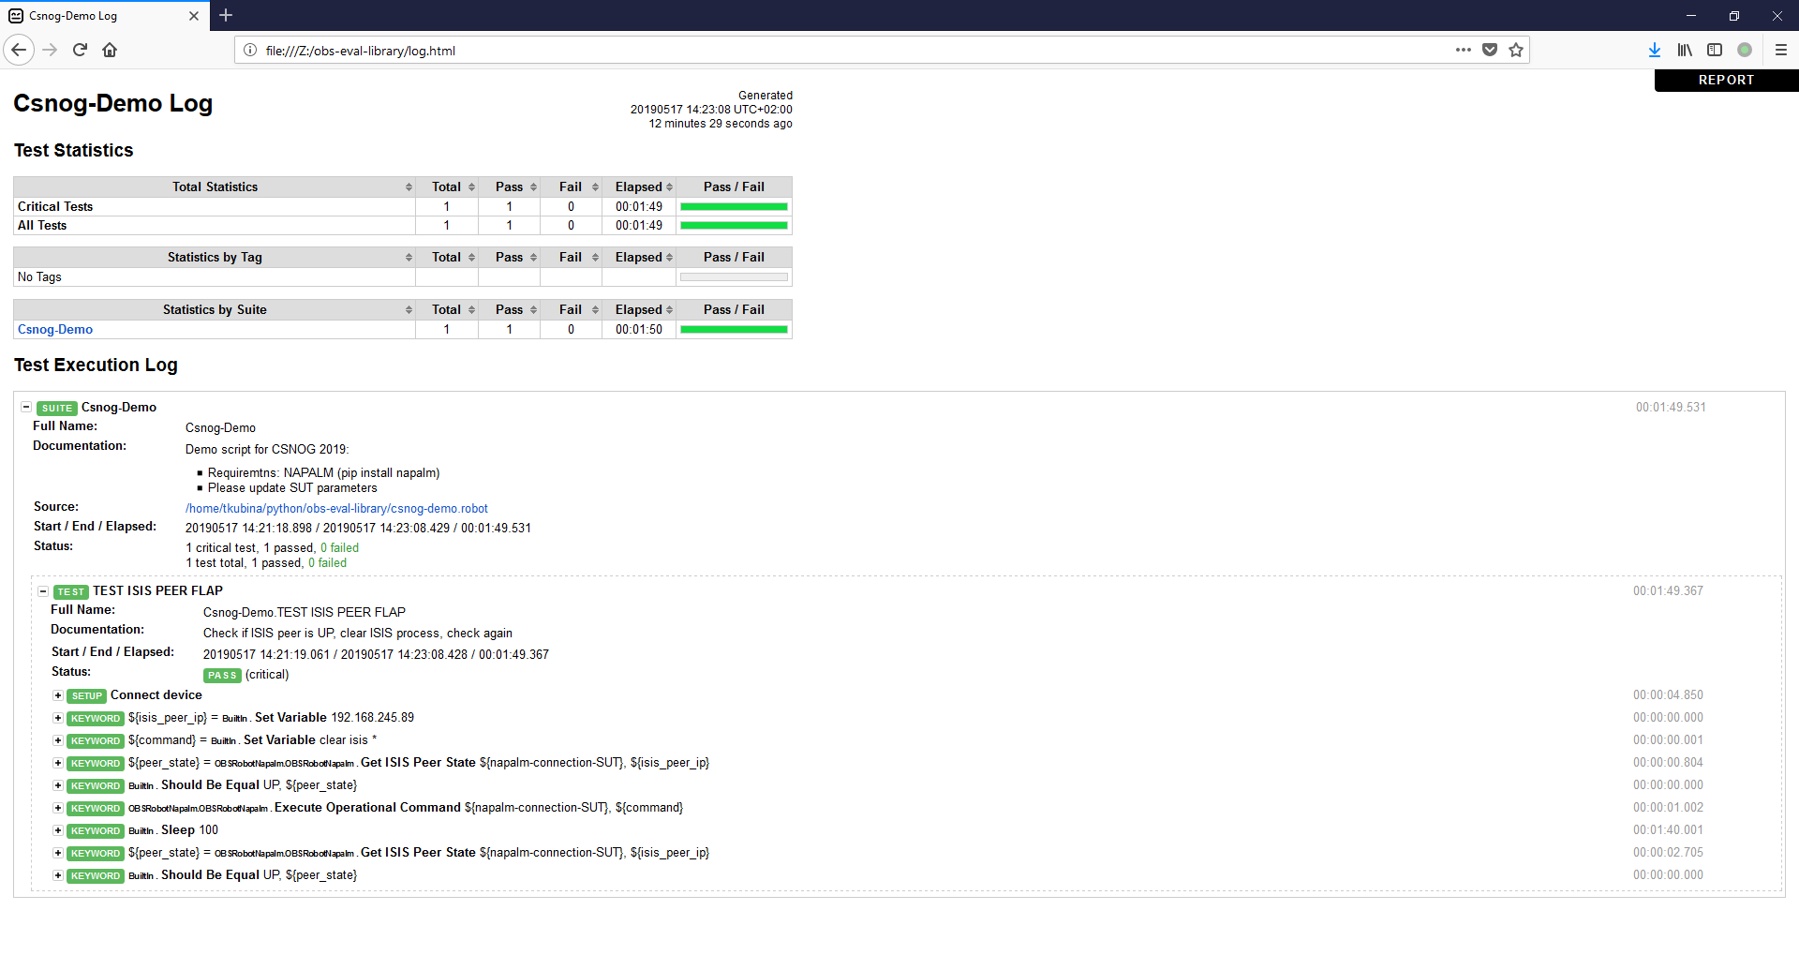
Automated network OS testing
Robot Framework html report

Slide 20
Automated network OS testing
Robot Framework OBSRobotNapalm.py keyword library
from napalm import get_network_driver
from robot.api.deco import keyword
@keyword('Napalm Connect')
def napalm_connect(device, login, password):
driver = get_network_driver('ios')
device = driver(device, login, password)
device.open()
return device
@keyword('Get ISIS Peer State')
def get_isis_peer_state(device, peer_ip):
isis_peers = device.get_isis_neighbors_detail()
for peer_name in isis_peers:
for interface in isis_peers[peer_name]:
if isis_peers[peer_name][interface]['ip_address'] == \ peer_ip:
return isis_peers[peer_name][interface]['state']
return 'None'
@keyword('Execute Operational Command')
def execute_op_command(device, command):
return device._send_command(command)

Slide 21
Automated network OS testing
Thank you!

Slide 22
Automated network OS testing
Resources:
NAPALM https://napalm-automation.net/
Netmiko https://github.com/ktbyers/netmiko
Ansible https://github.com/ansible
YDK http://ydk.cisco.com/py/docs/#
Junos PyEZ https://github.com/Juniper/py-junos-eznc
NETCONF https://tools.ietf.org/html/rfc6241
YANG https://napalm-automation.net/yang-for-dummies/
Robot Framework http://robotframework.org
updated NAPALM repo:
https://github.com/tomaskubina/napalm/tree/obs_nie_experiment

